Slide 1
Project 3--One-Step RNA Virus Detection System
Elizabeth Carlson, Hamilton HS, Biology
Eryn Ruder, Northwest HS, Biology & Anatomy/Physiology
Mentors:
Dr. David Wendell, Assistant Professor, Environmental Engineering
Ms. Elizabeth Wurtzler, Graduate Student, Environmental Engineering

Slide 2
Table of Contents
Introduction
Background/Literature Review
Goals and Objectives
Timeline
Research Training
Research Tasks
Research Progress
Unit Progress – Carlson
Unit Progress- Ruder

Slide 3
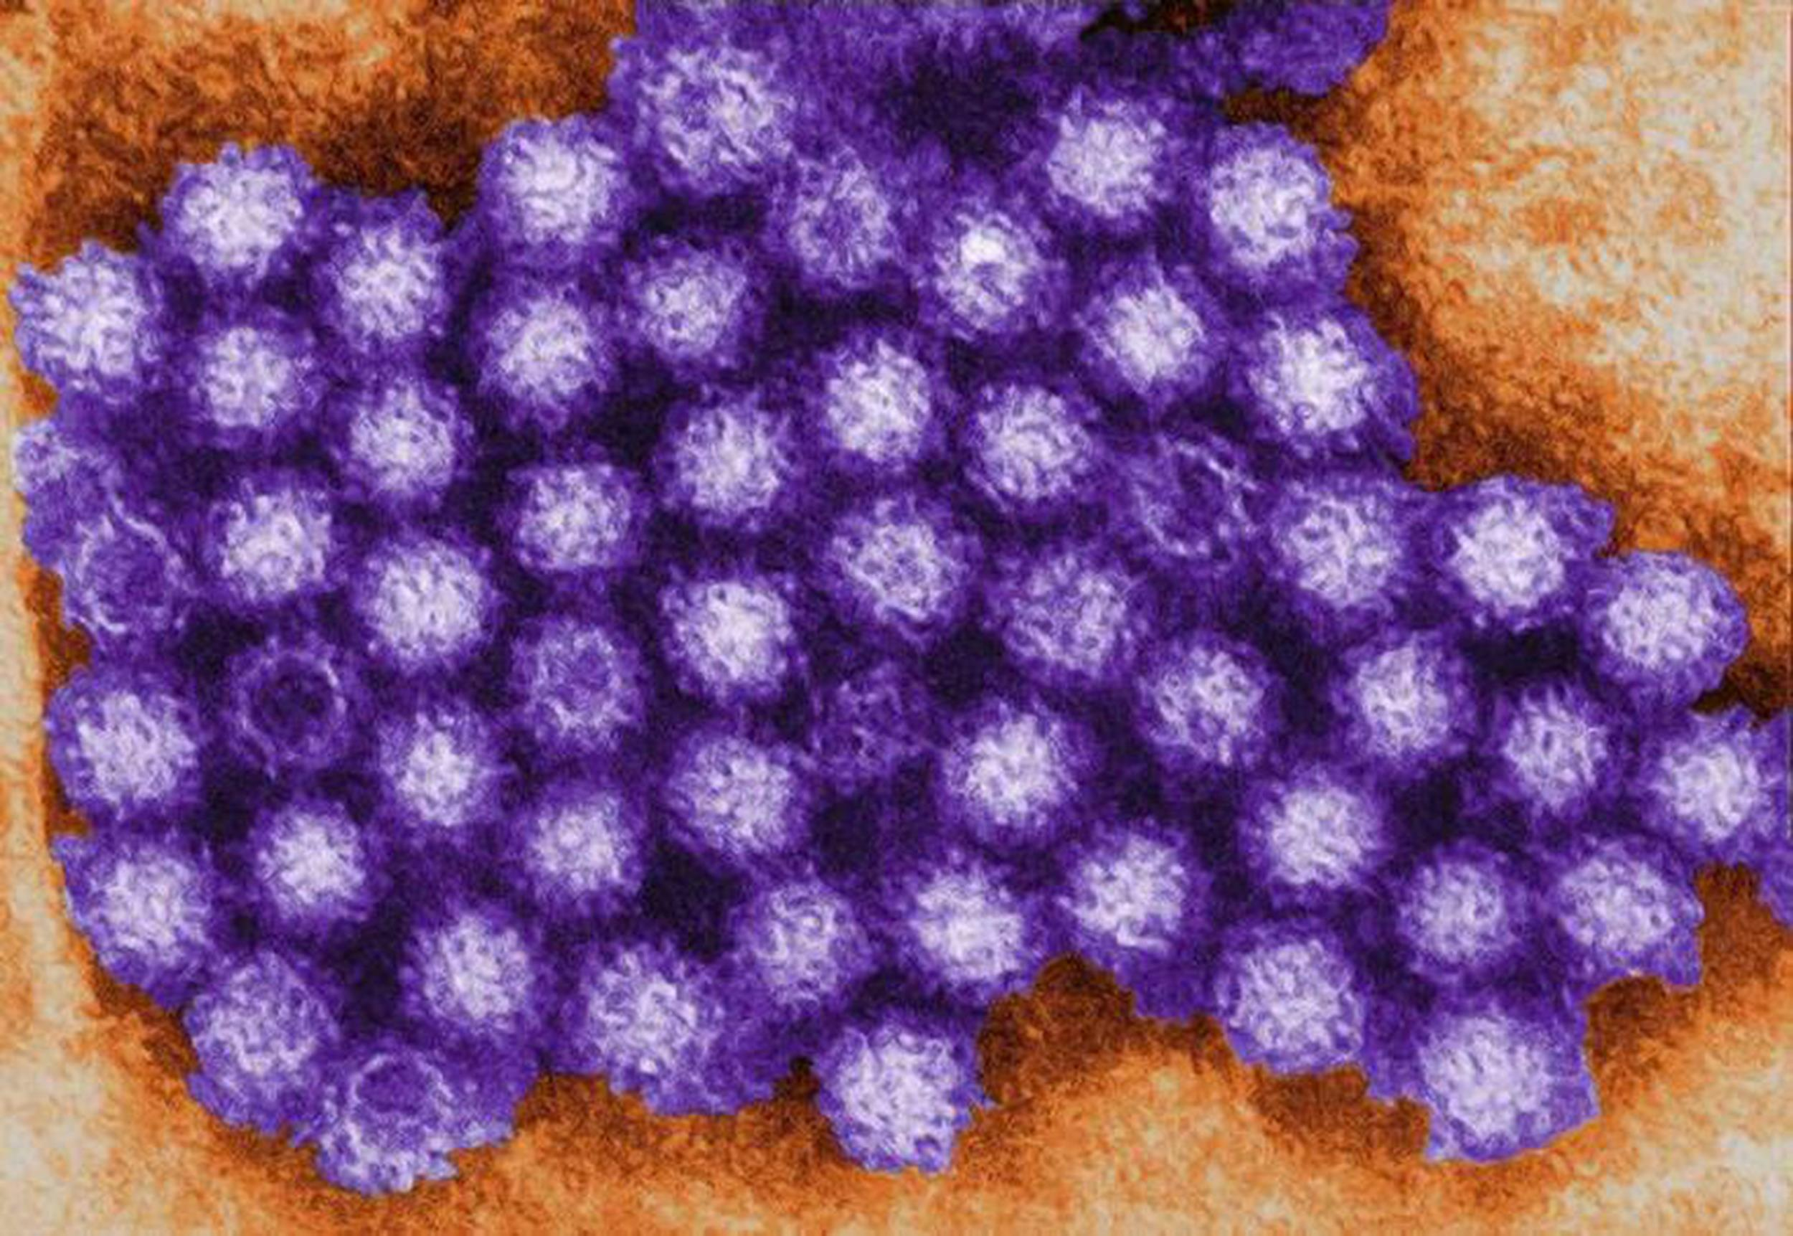
Introduction
Norovirus is an RNA, non-enveloped very contagious virus.
In the United States, norovirus is the most common cause of acute gastroenteritis and foodborne-disease outbreaks.
Norovirus causes
19-21 million illnesses
56,000-71,000 hospitalizations
570-800 deaths each year.

Slide 4
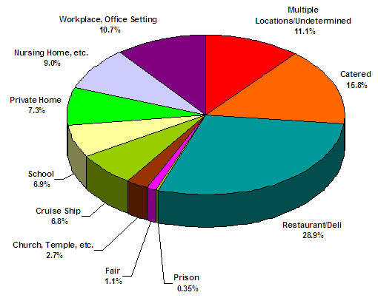
Introduction (cont.)
Association of Nutrition and Food Service Professionals

Slide 5
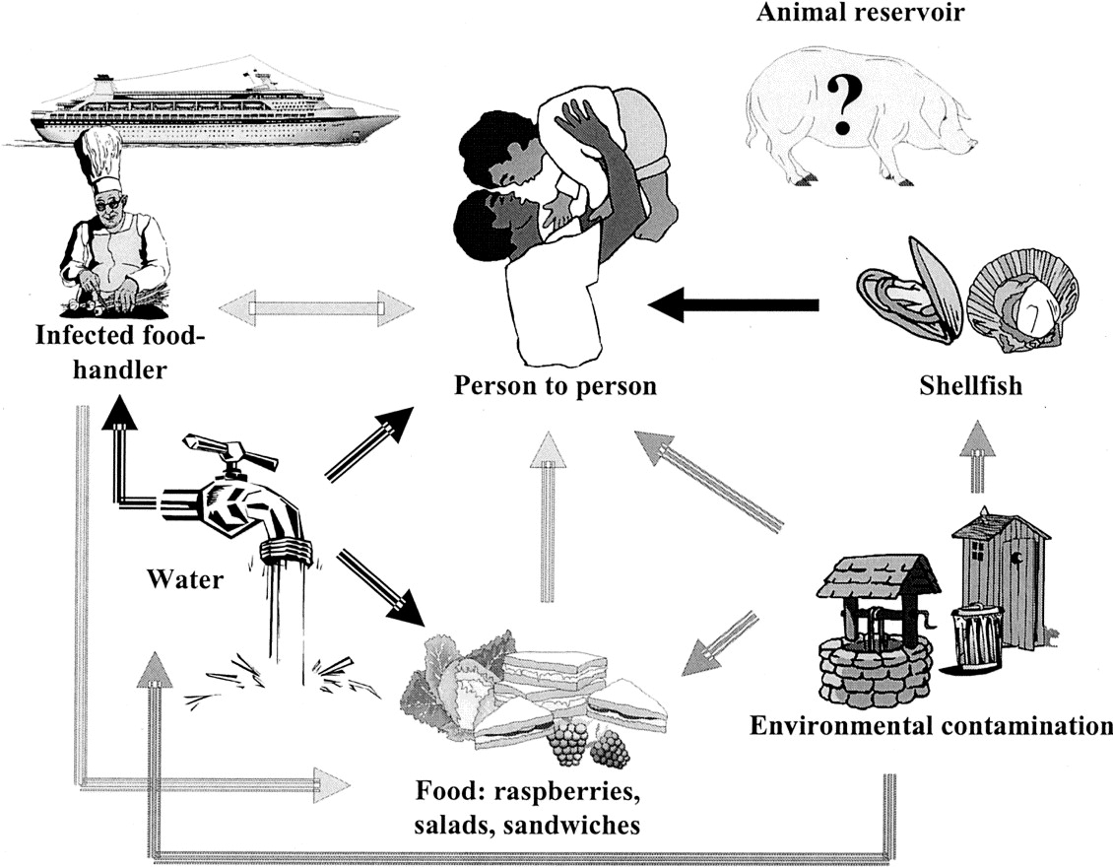
Introduction (cont.)
http://www.cruiselawnews.com/

Slide 6
Introduction (cont.)
Lack of fast, routine diagnostic methods for detecting the norovirus.
Recent advances in the use of DSN (Duplex Specific Nuclease) signal amplification have enabled researchers to detect microRNAs through fluorescence.
Goal of this project is to create a one-step RNA virus detection system for the norovirus.

Slide 7
Literature Review
Current methods for detecting norovirus are expensive, require specialized equipment, and are time consuming.
Human norovirus can not be grown in cell culture.
Result: Detection methods focus on viral RNA or antigen

Slide 8
Literature Review (cont.)
Current Methods of Detection:
Real-time reverse transcription-polymerase chain reaction (RT-qPCR) assays
Conventional RT-PCR assays for genotyping
Enzyme immunoassays (EIAs) are a recent development
Notes:
PCR methods are not cheap, quick, nor easy.
EIAs are Sold in kits but poor sensitivity (50%)
Not recommended to replace PCR in outbreak investigations.

Slide 9
Literature Review (cont.)
Duplex-specific Nuclease (DSN) from the Kamchatka crab
DSN detects short sequences of RNA nucleotides (microRNAs)
Norovirus target material is longer than DSN’s preferred length.

Slide 10
Goals & Objectives of Research Project
To improve the single step RNA virus detection assay
Long term goal--Ideally, public health officials would have a “Norovirus Identification Kit”
Quick detection
treatment
sanitation
quarantine
Notes:
containing a packet of enzymes and a packet of probes

Slide 11
Timeline

Slide 12
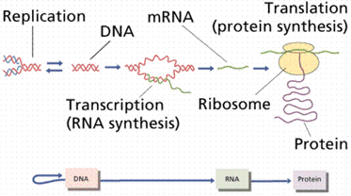
Research Training Received
The Central Dogma of Molecular Biology
http://rpdp.net/sciencetips_v2/L12A2.htm

Slide 13
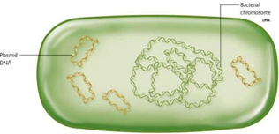
Research Training Received
Bacteria have a single main chromosome, but can contain many plasmids.
www.bio.miami.edu/~cmallery/150/gene/mol_gen.htm
Bacterial
Chromosome
Plasmid
DNA

Slide 14
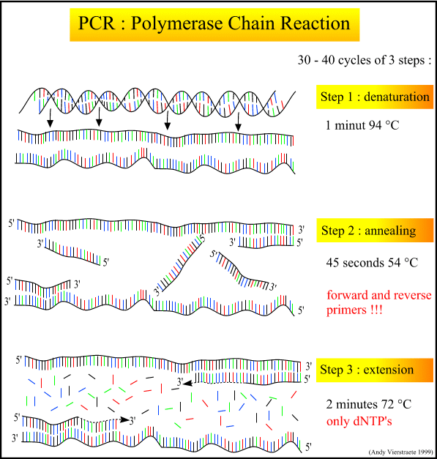
Research Training Received
PCR--Polymerase Chain Reaction
Goal-production of specific DNA fragment

Slide 15
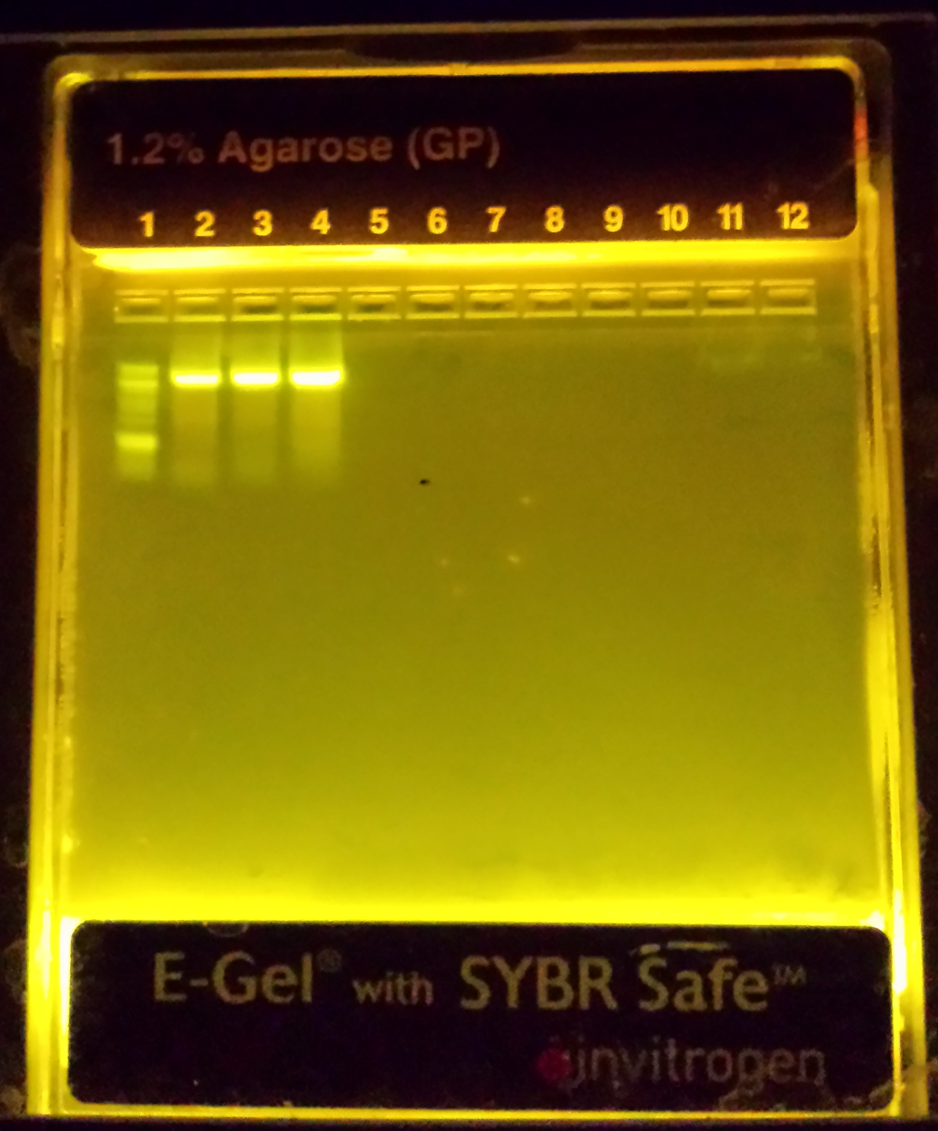
Research Training Received
Electrophoresis
Shows relative weight and amount of product
Shorter strands travel further through the gel

Slide 16
Research Training Received
Quantitative PCR (qPCR)
Taqman probes or molecular beacons
When F and Q are separated, the reporter fluoresces

Slide 17
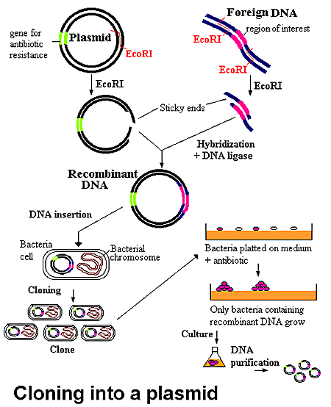
Research Training Received
Site-directed mutagenesis
http://www.accessexcellence.org/RC/VL/GG/images/PLASMID.gif

Slide 18
Research Training Received
Protein production is stimulated using the Lac operon and IPTG.

Slide 19
Research Tasks
Creation of three mutated plasmids
Protein production
Enzymatic activity testing

Slide 20
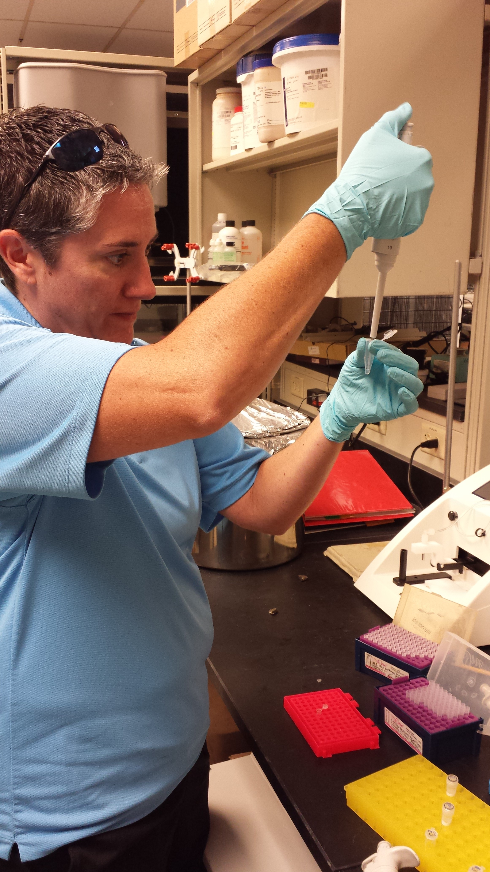
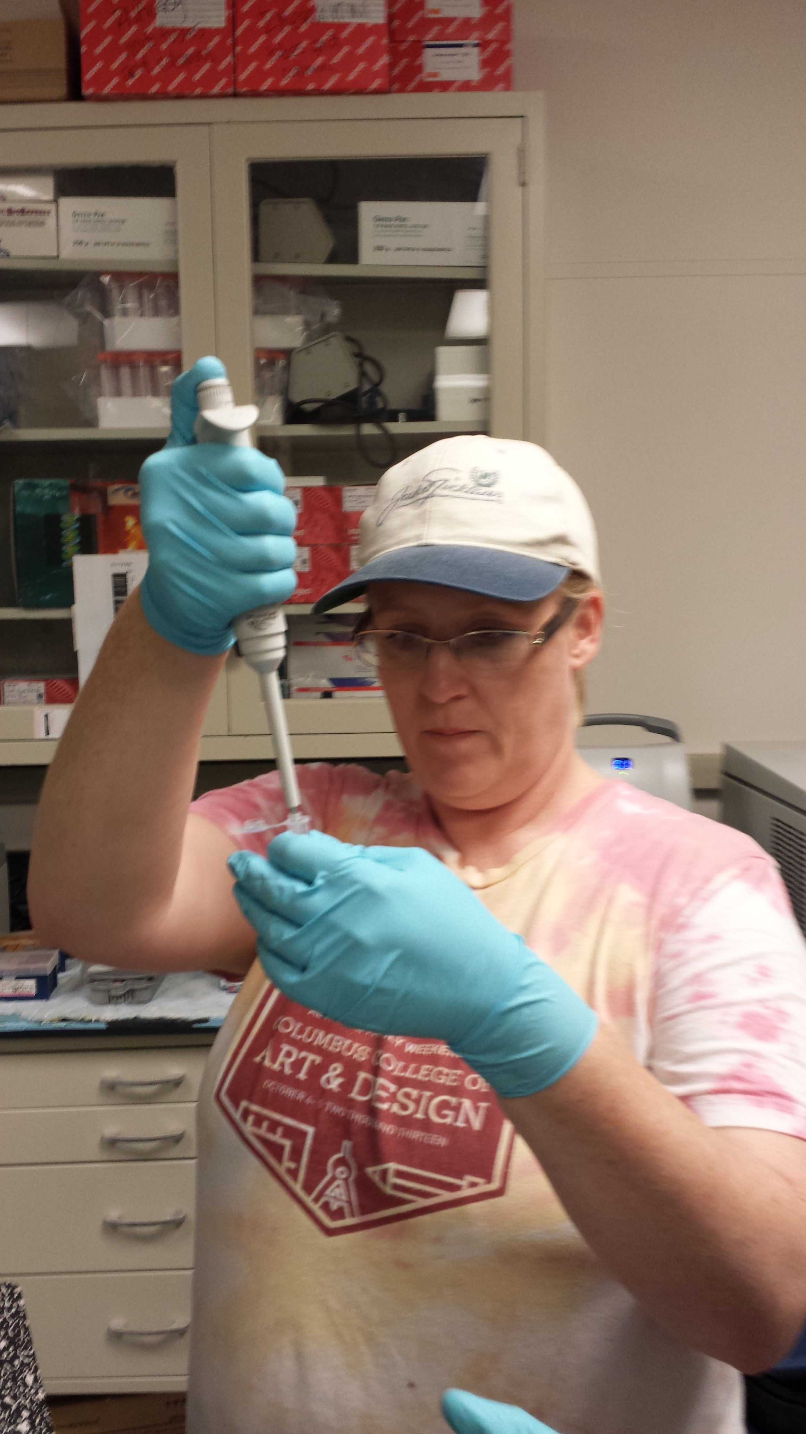
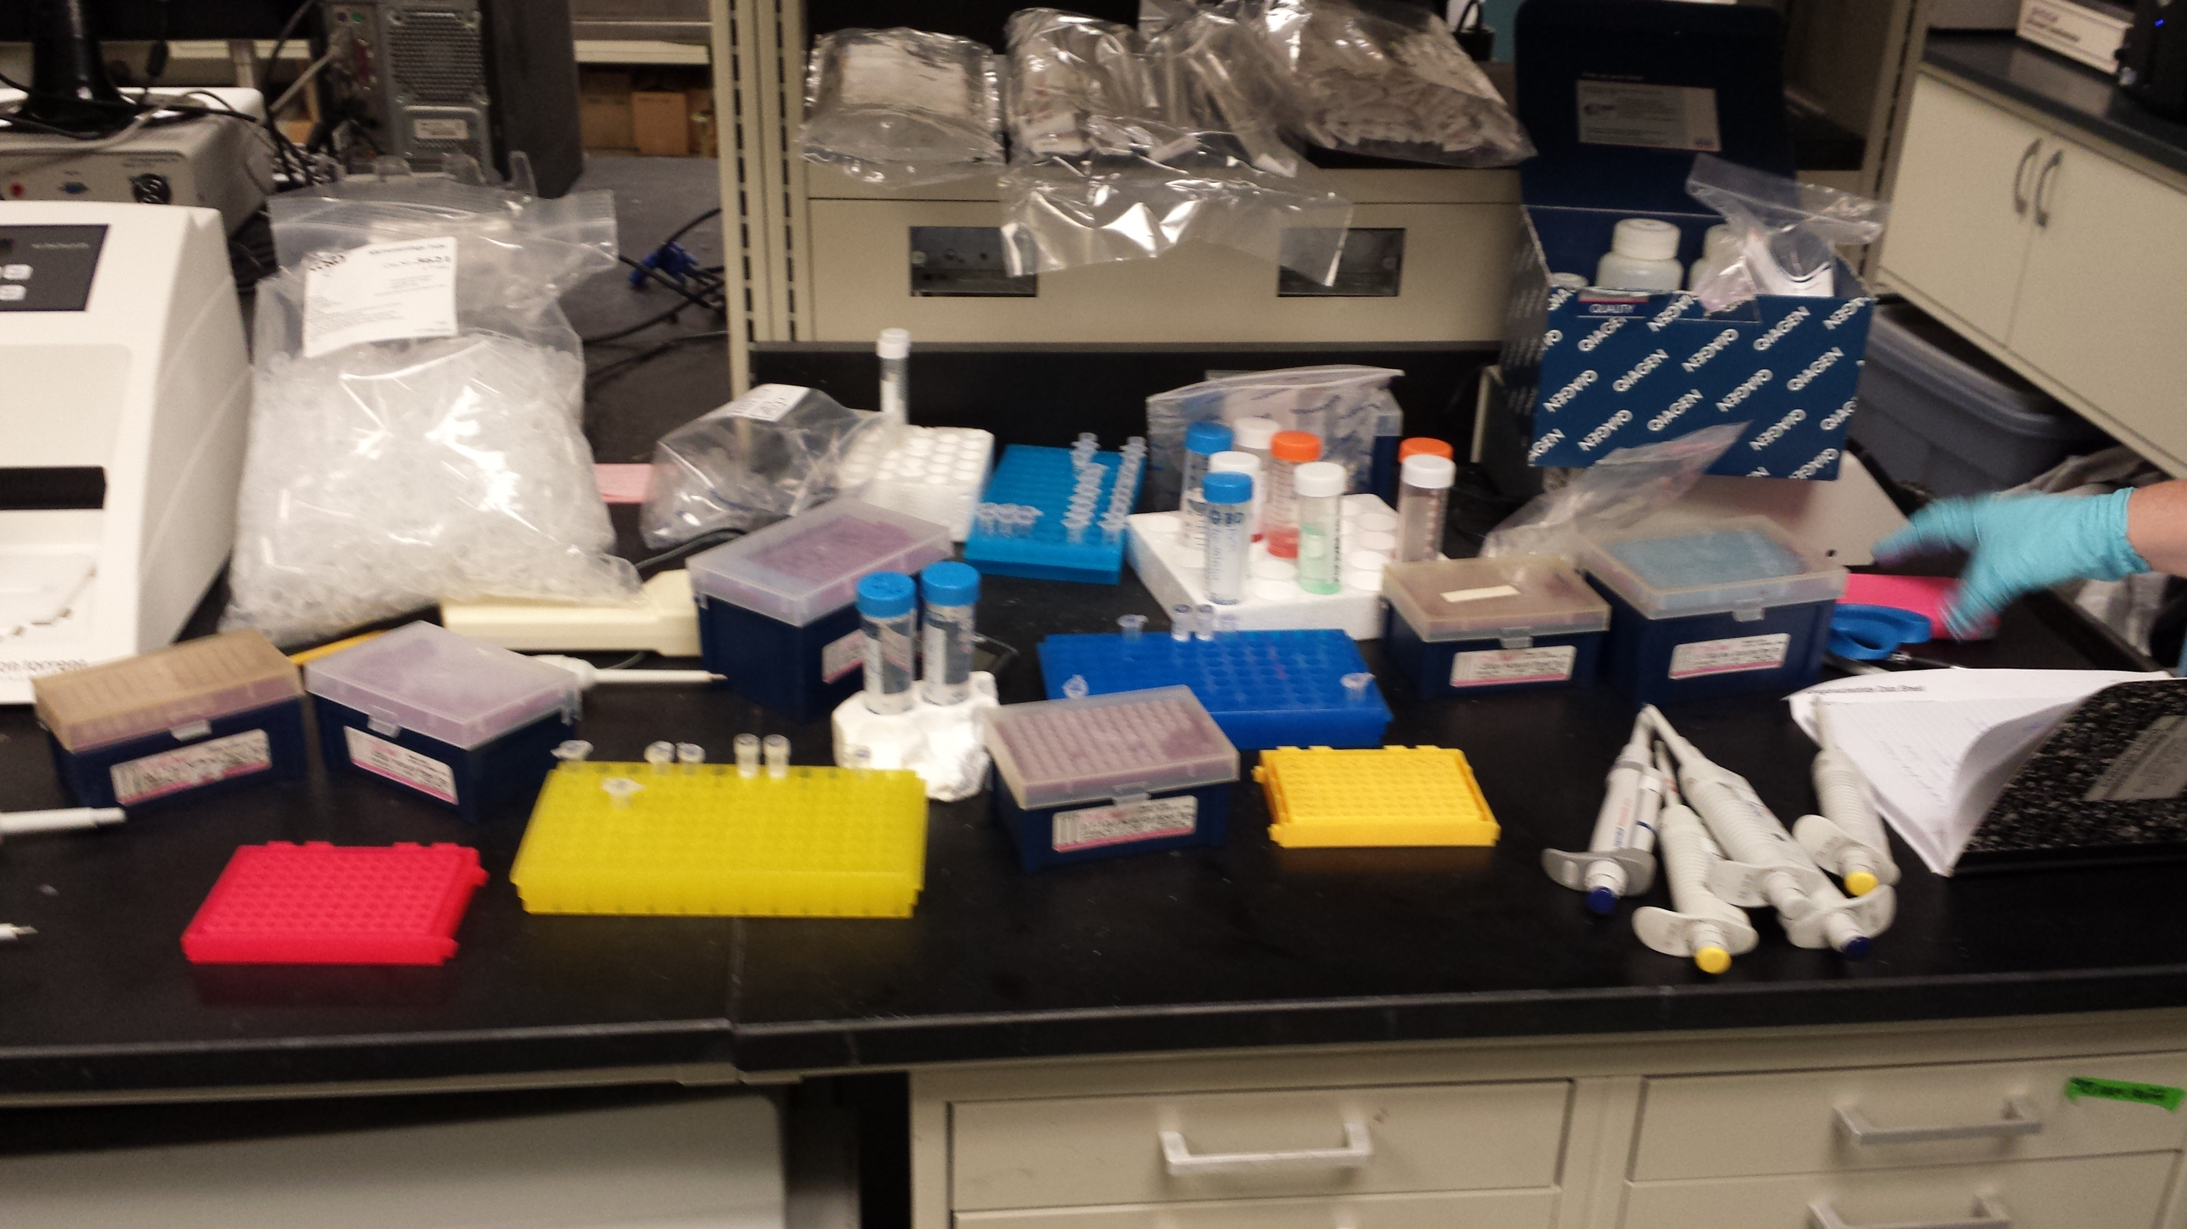
Lab Progress—Create Plasmids
PCR Reaction- creation of mutated sequences

Slide 21
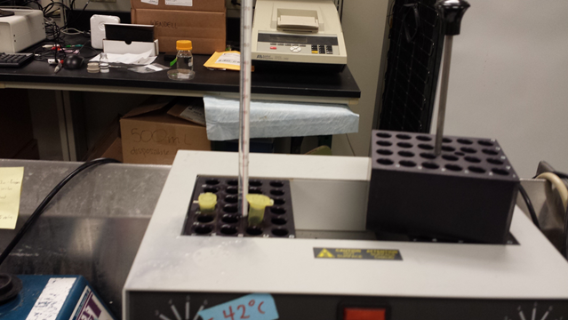
Lab Progress—Create Plasmids
Infusion--plasmid creation
Transformation-uptake of mutated plasmids into E. coli

Slide 22
Lab Progress—Create Plasmids
Incubation-plate bacteria and allow to grow
Transferred colonies into liquid media, allowed to grow overnight

Slide 23
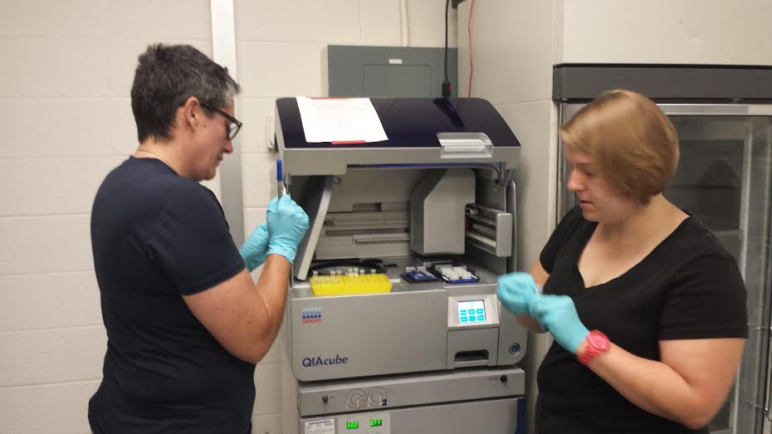
Lab Progress—Create Plasmids
Purification—extracted mutated plasmid from bacteria

Slide 24
Lab Progress—Create Plasmids
Submit samples for sequencing at Children’s DNA Core Sequencing Unit

Slide 25
Lab Progress—Create Plasmids
We successfully mutated sequences for DN, ND, & NN.

Slide 26
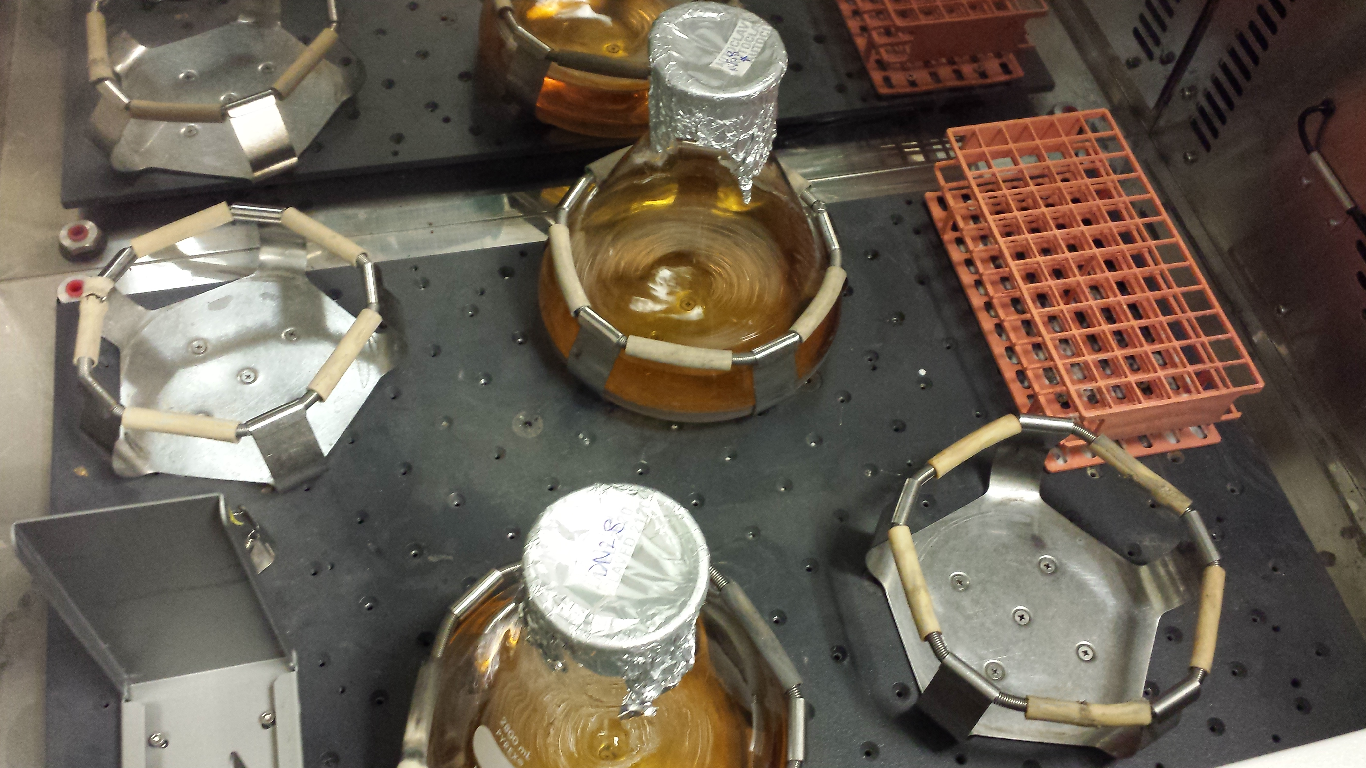
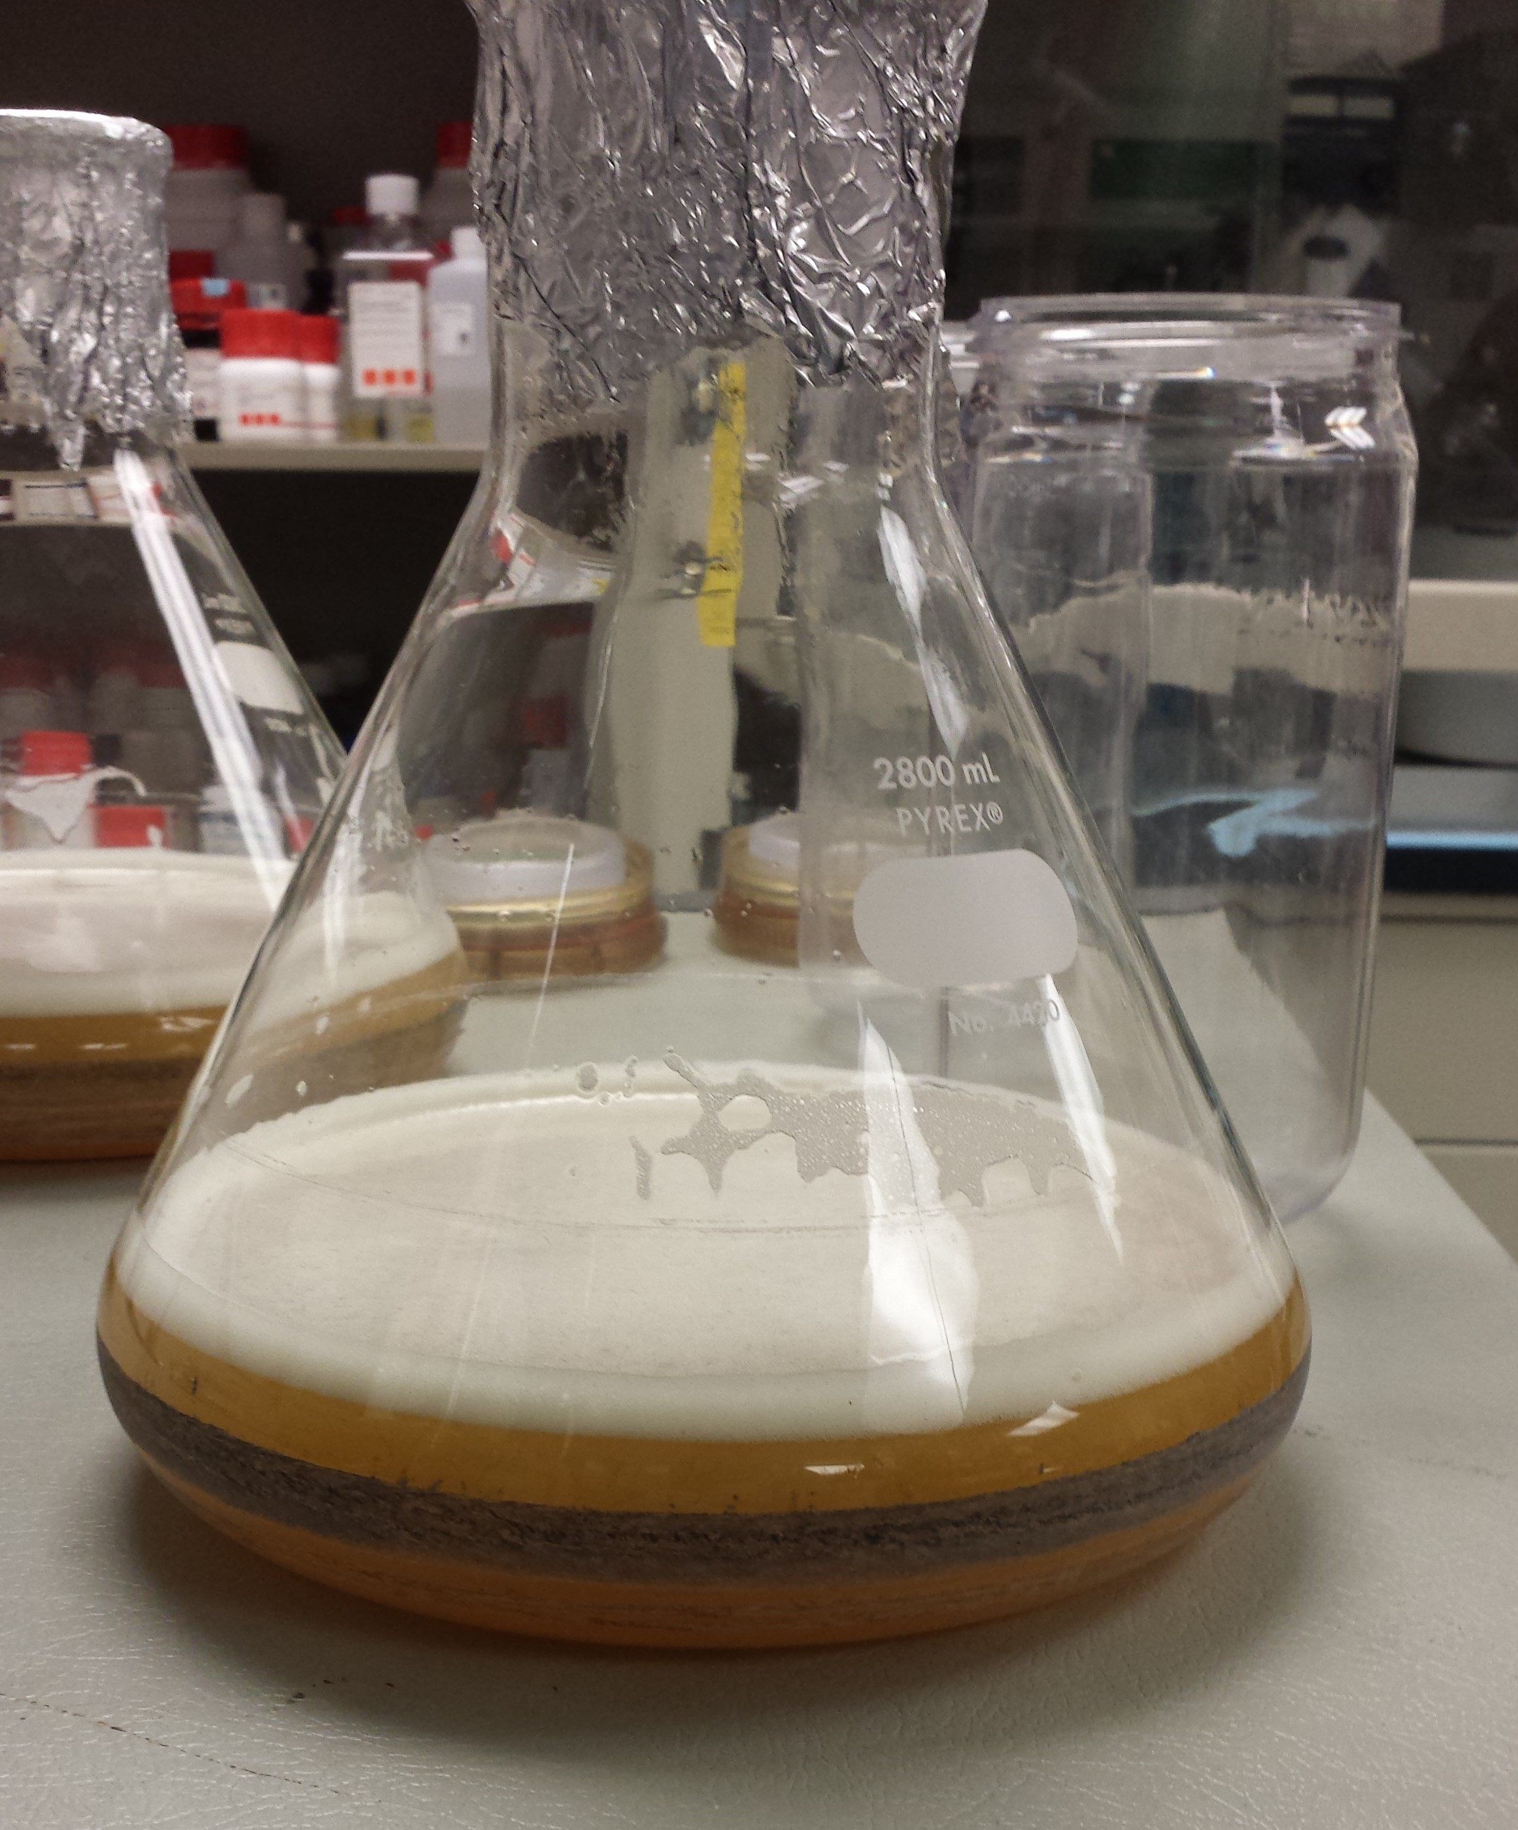
Lab Progress-Produce Proteins
Transform SHuffle T7 Express Competent E. coli
Incubate cells at 37˚C overnight
Move to Overnight Express Instant LB Medium
Incubate at 25˚C overnight—time to make proteins

Slide 27
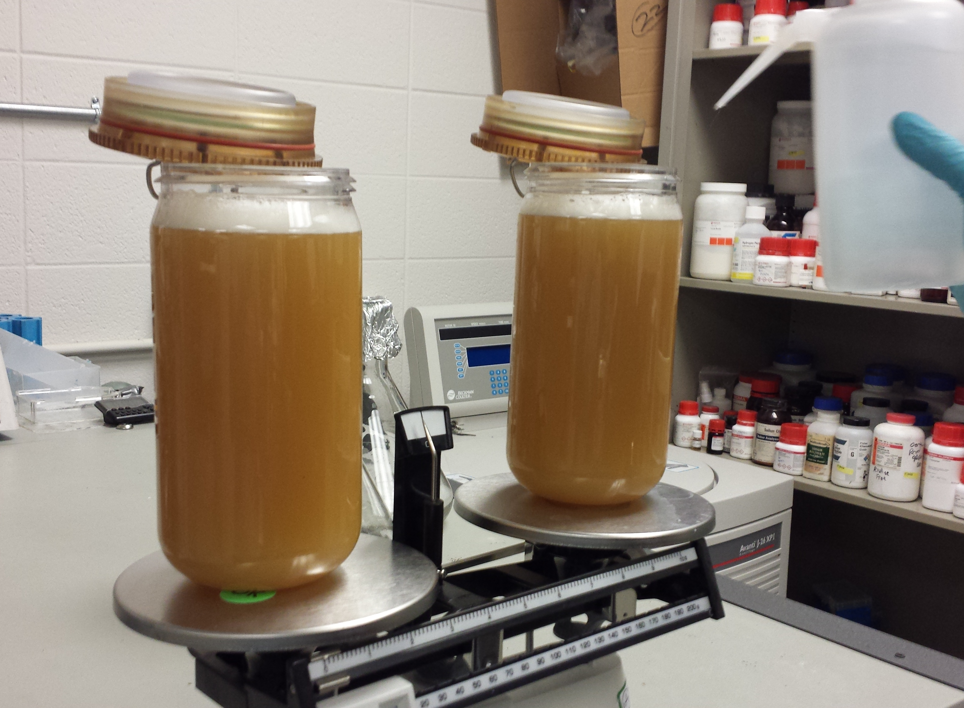
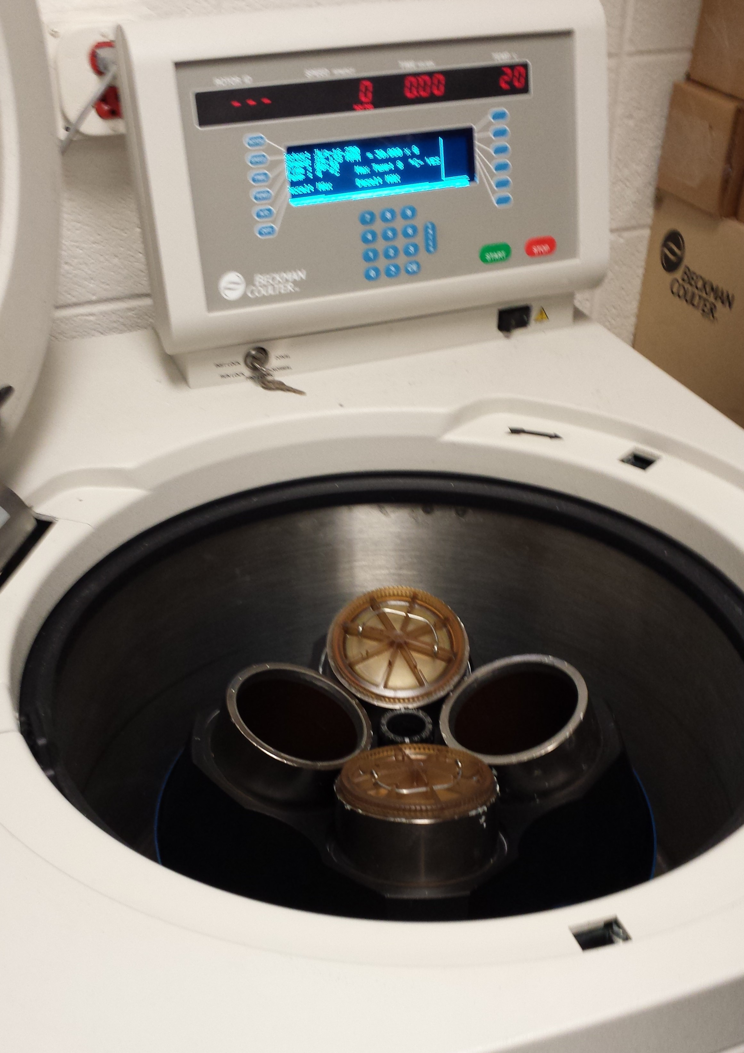
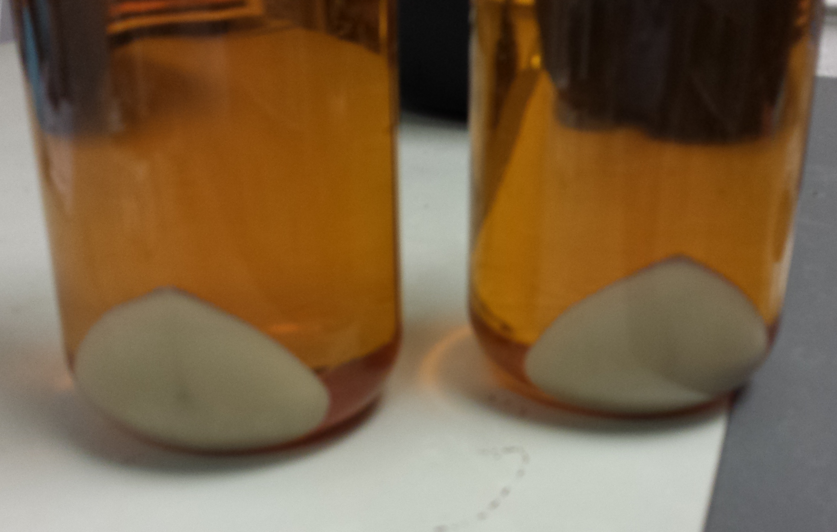
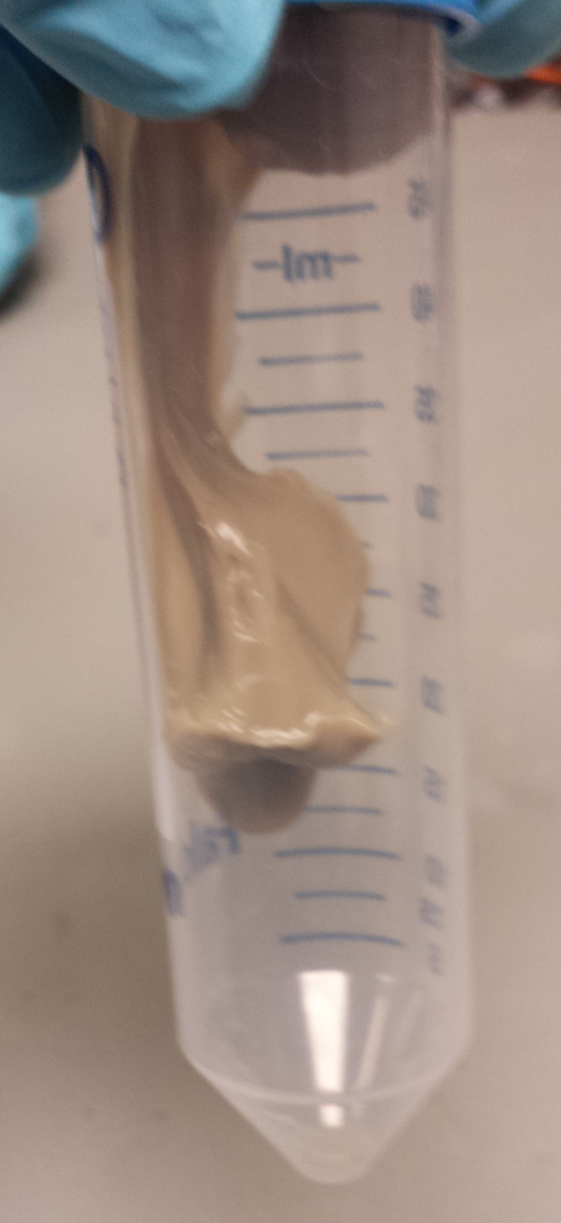
Lab Progress-Produce Proteins
Spin bacterial colonies in centrifuge
Pour off supernatant
Collect the pellet containing cells

Slide 28
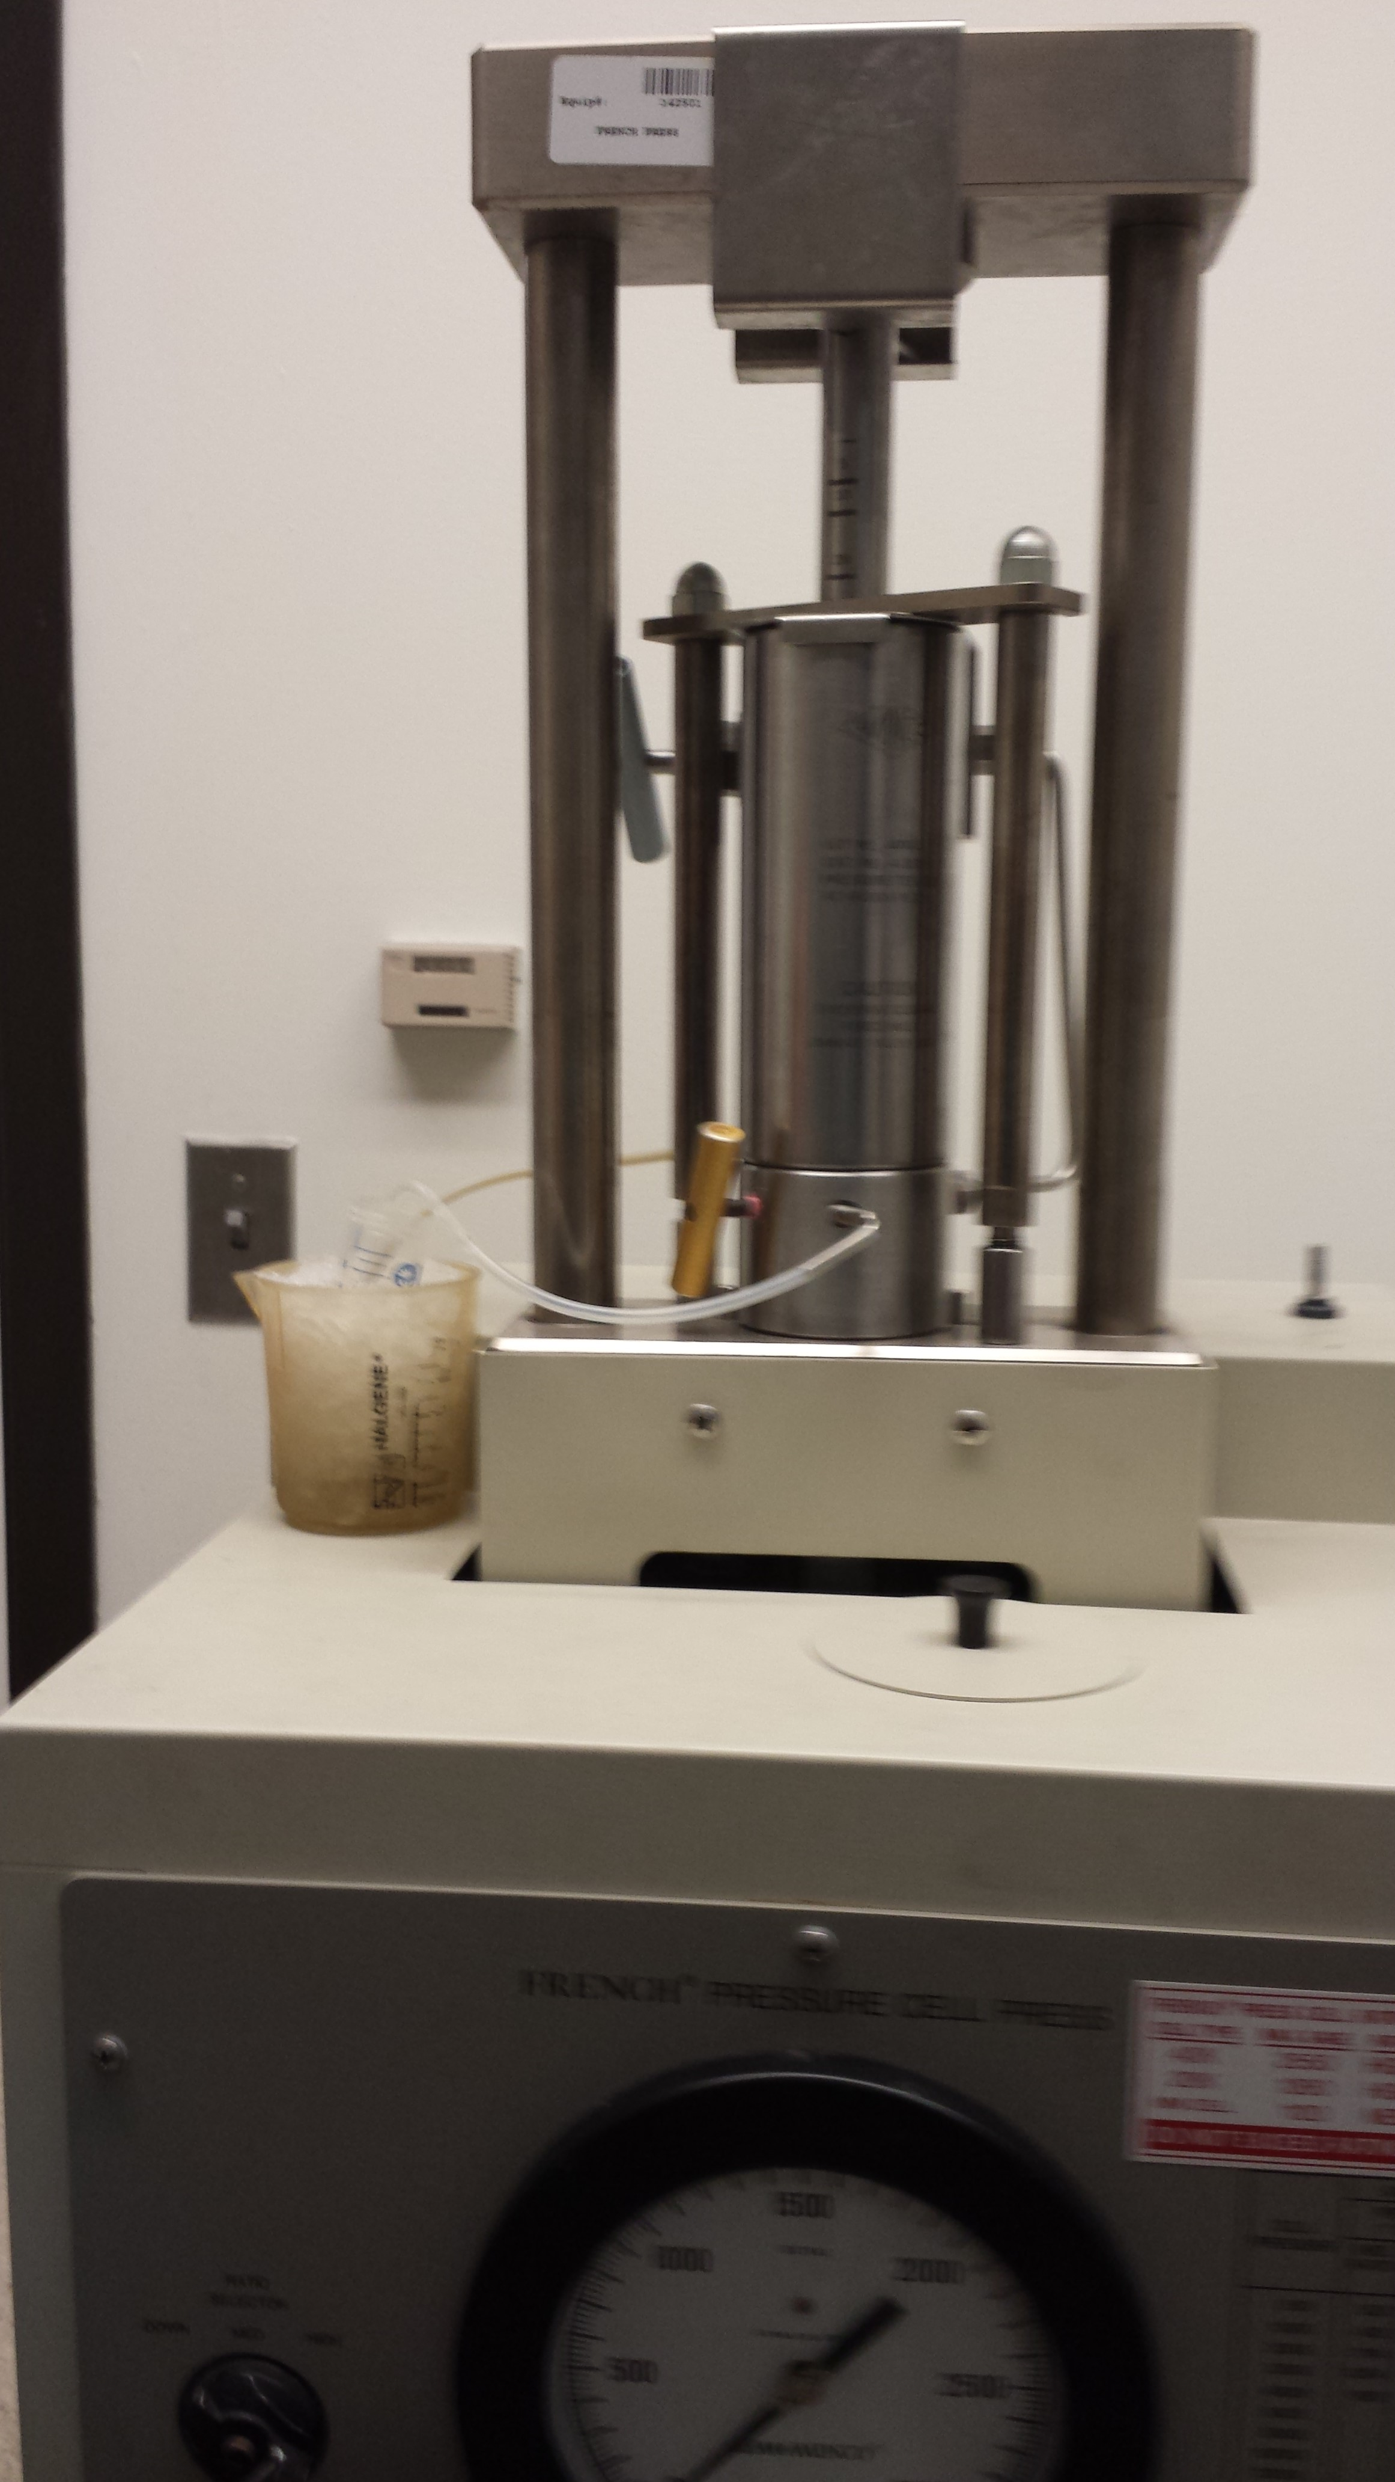
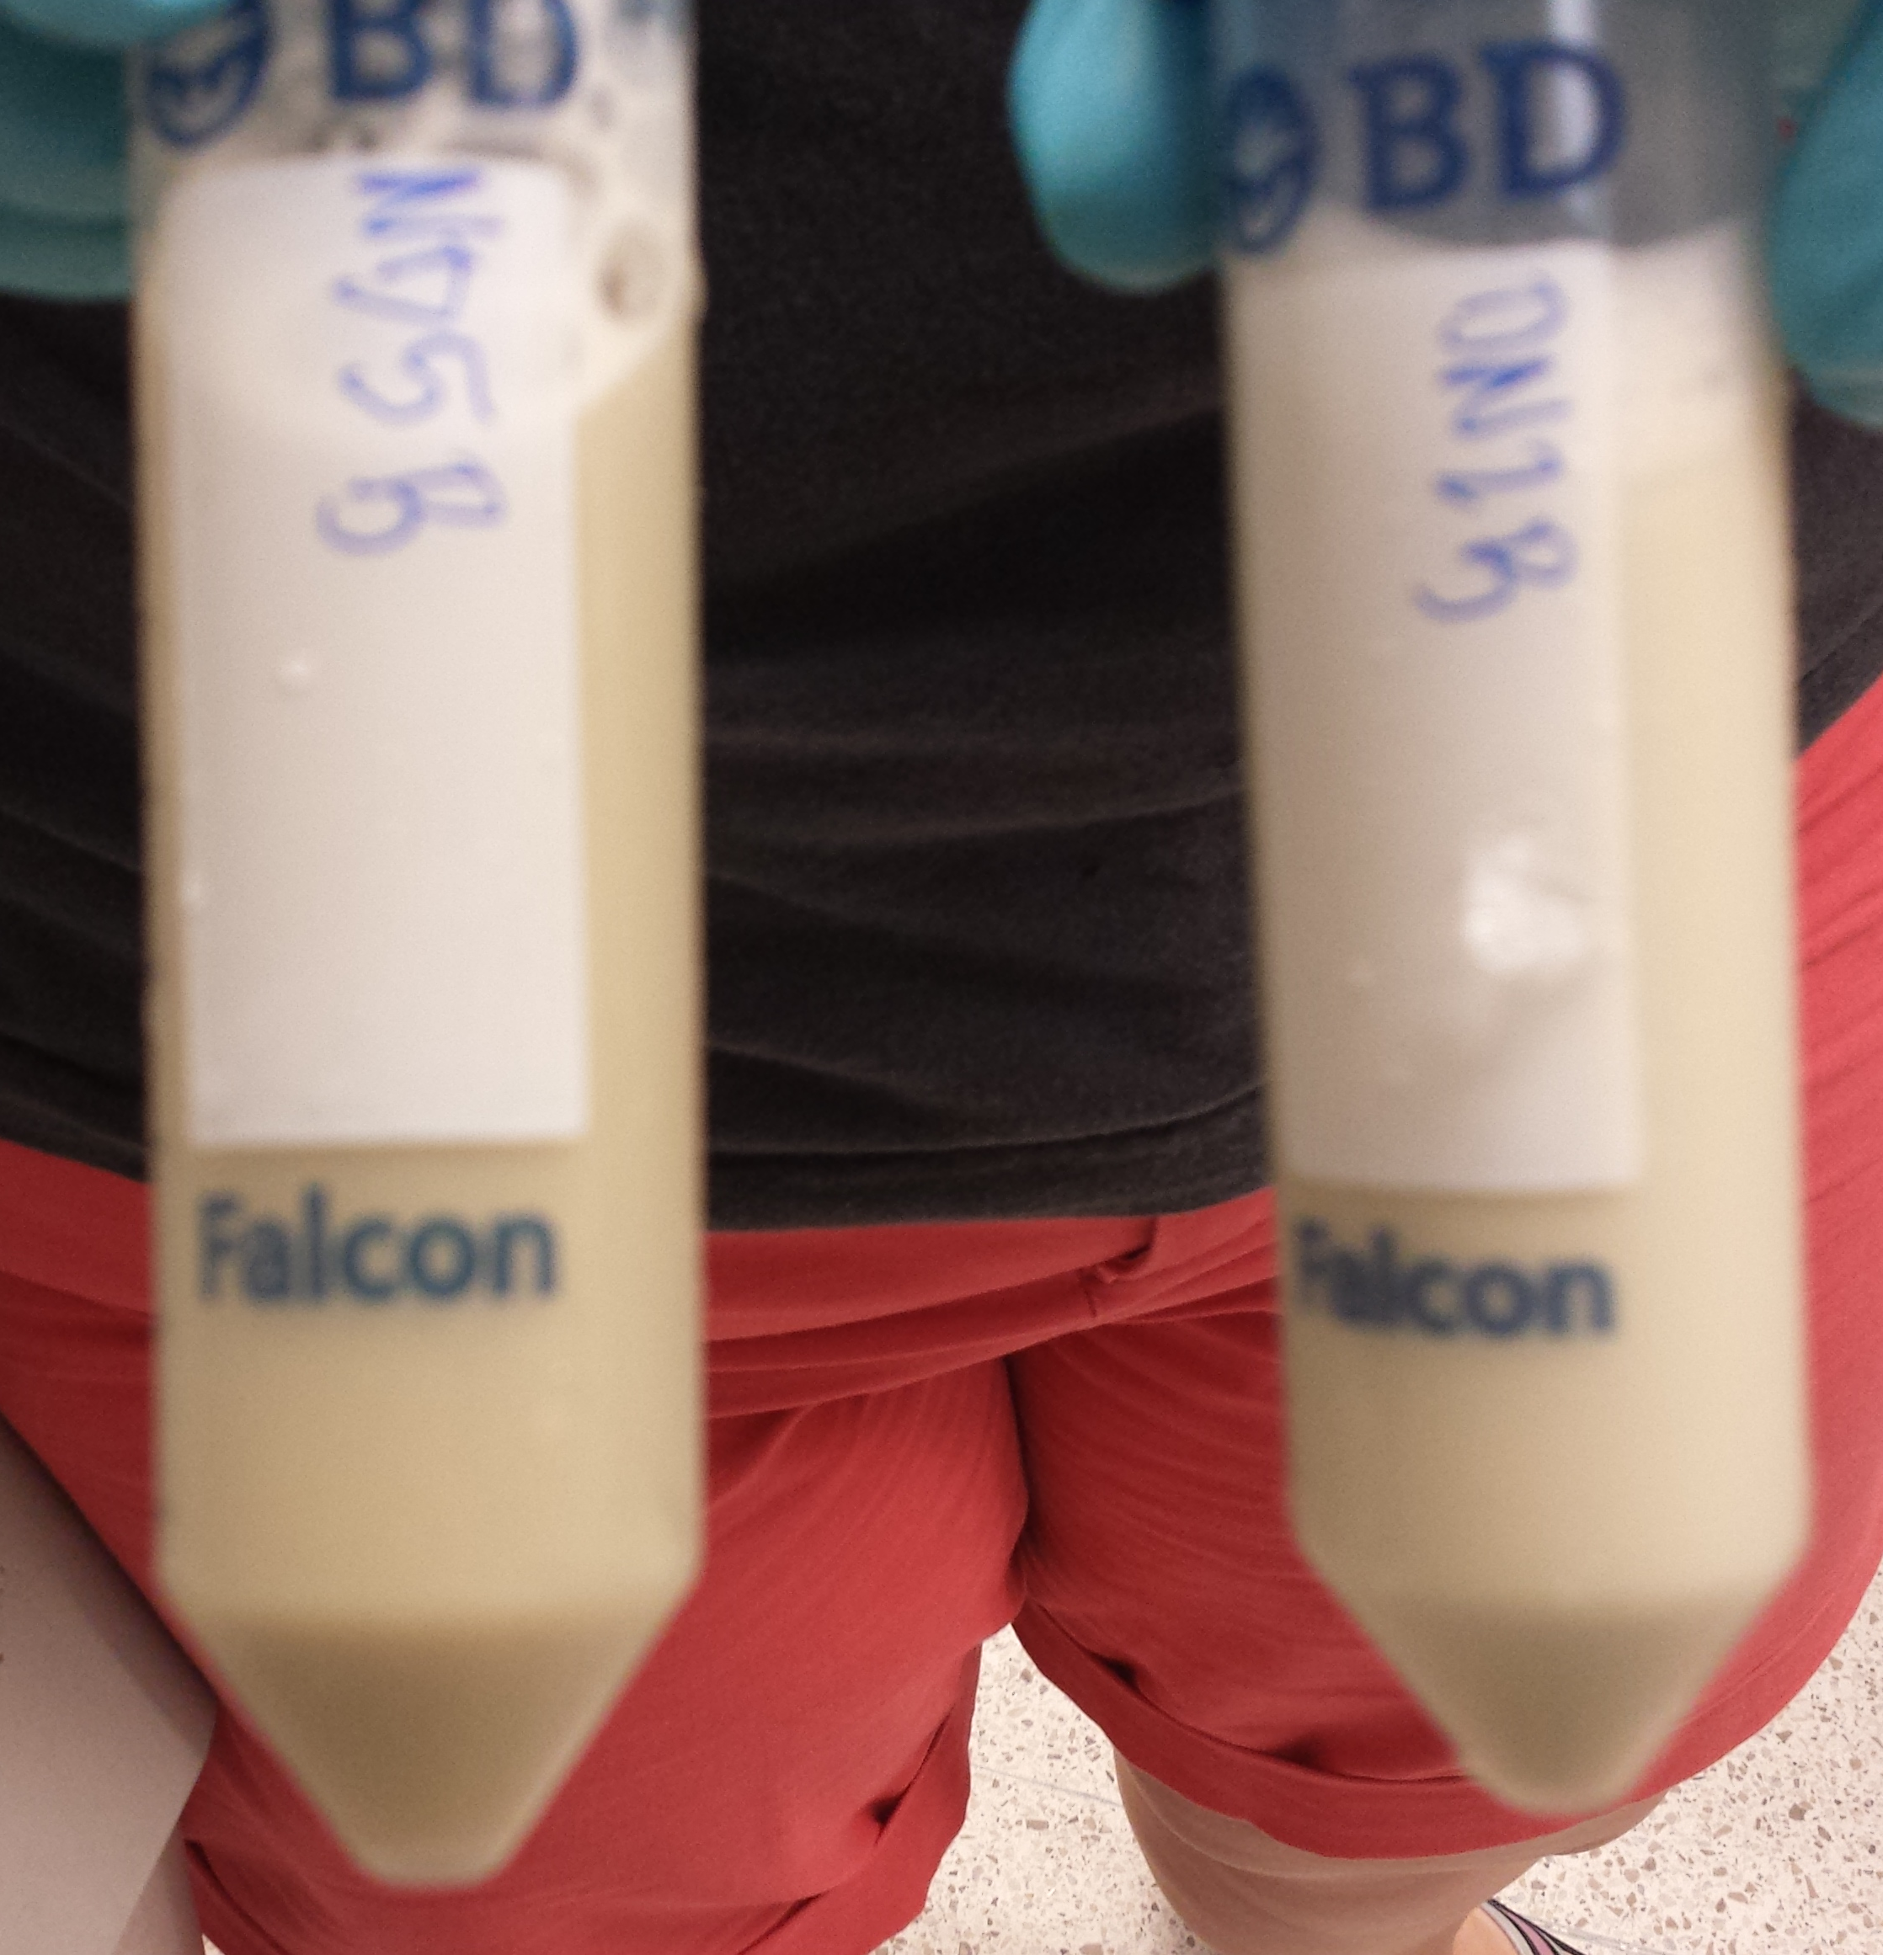
Lab Progress-Produce Proteins
Resuspend cells
Lyse cells using French press
Spin in centrifuge
Collect protein in supernatant

Slide 29
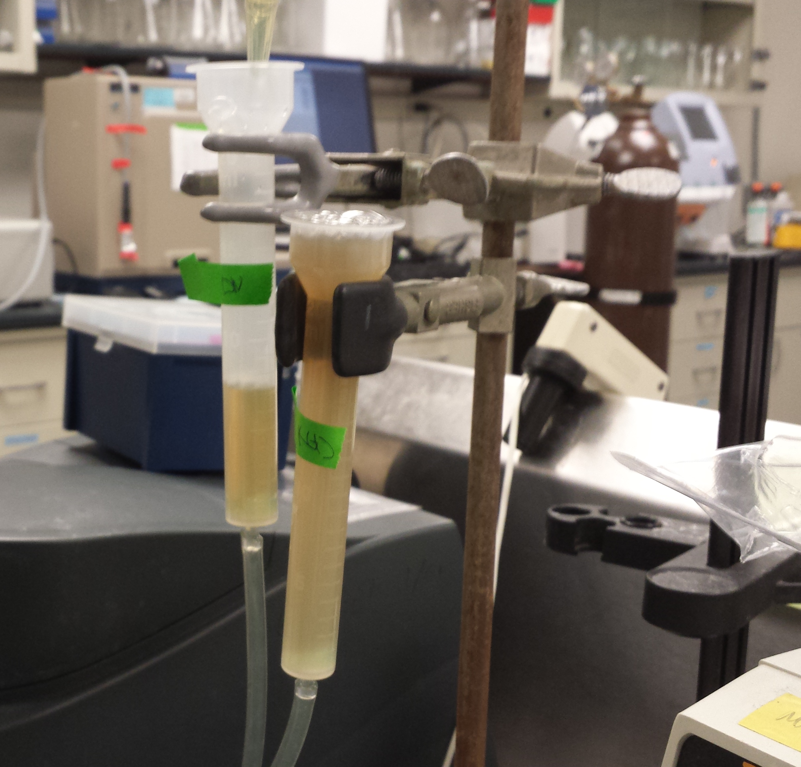
Lab Progress-Produce Proteins
Pull supernatant through a column using affinity chromatography
Collect protein under low pH and high imidazole conditions
Test with Bradford solution for presence of protein

Slide 30
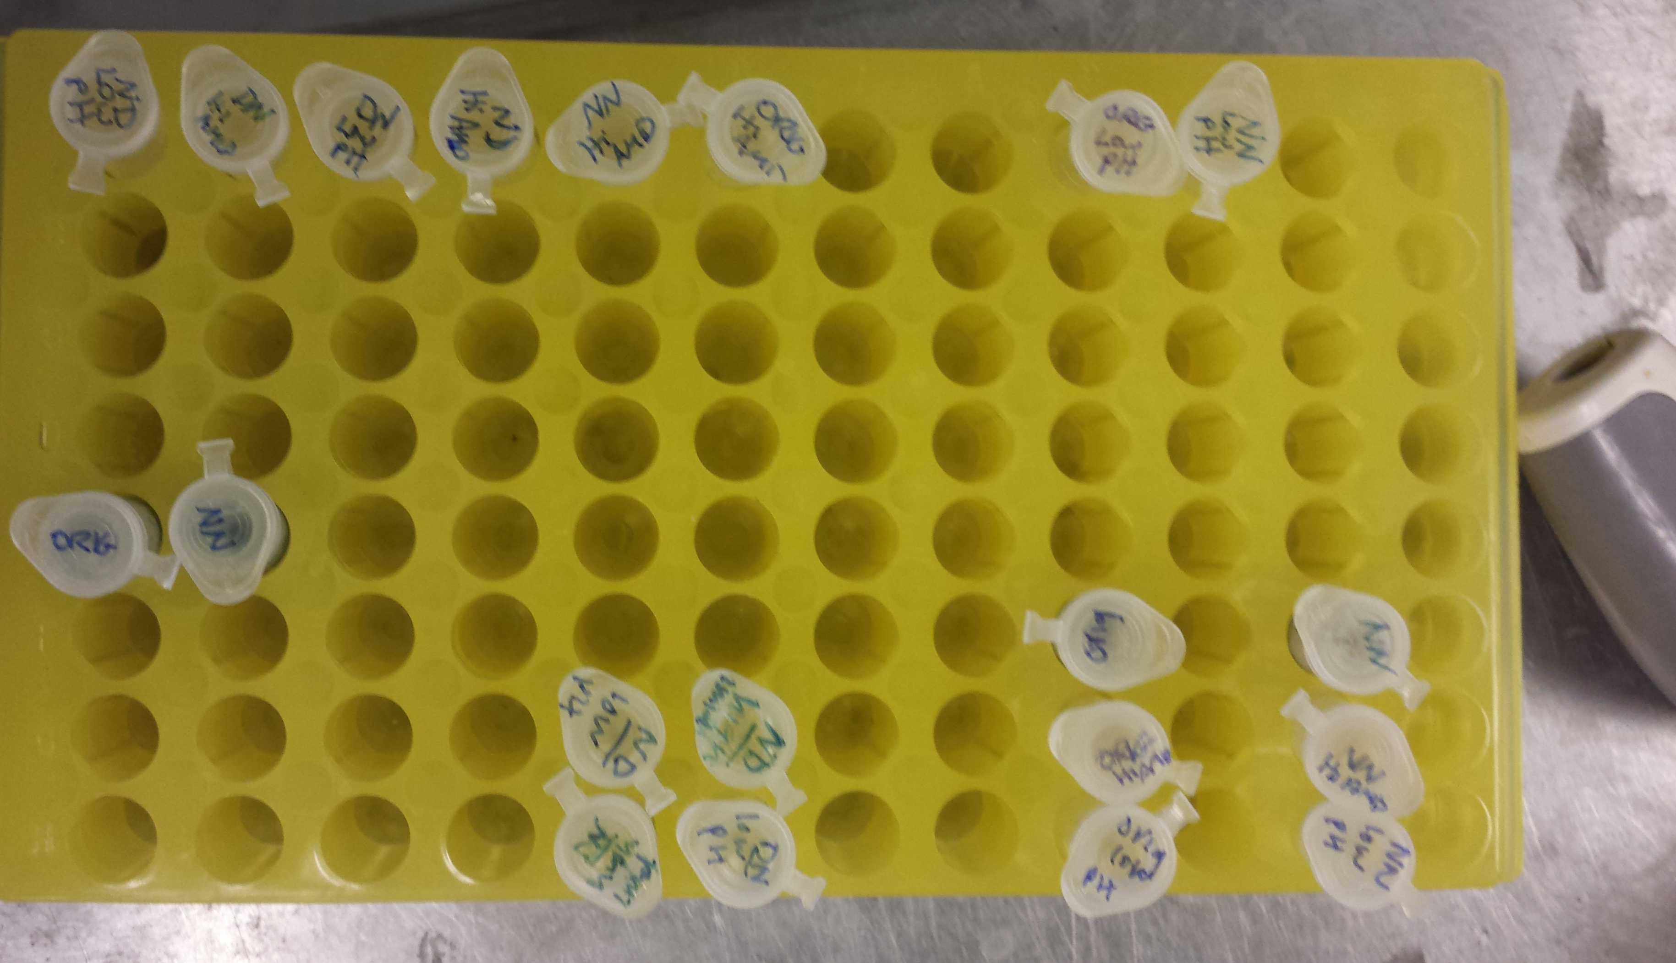
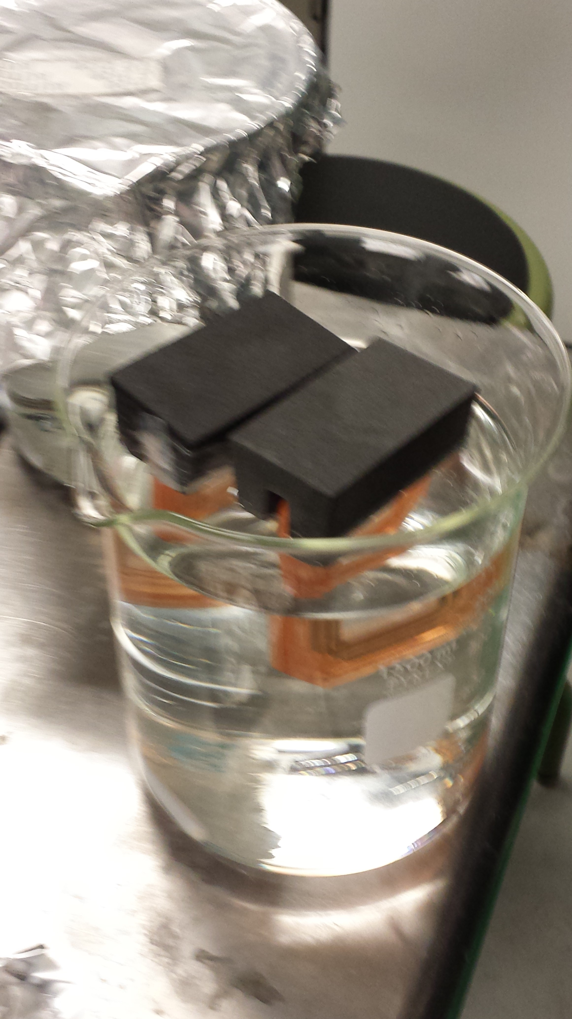
Lab Progress-Produce Proteins
Dialyzed protein to Δ pH, remove DTT & imidazole, add Mg
Stimulated correct protein folding

Slide 31
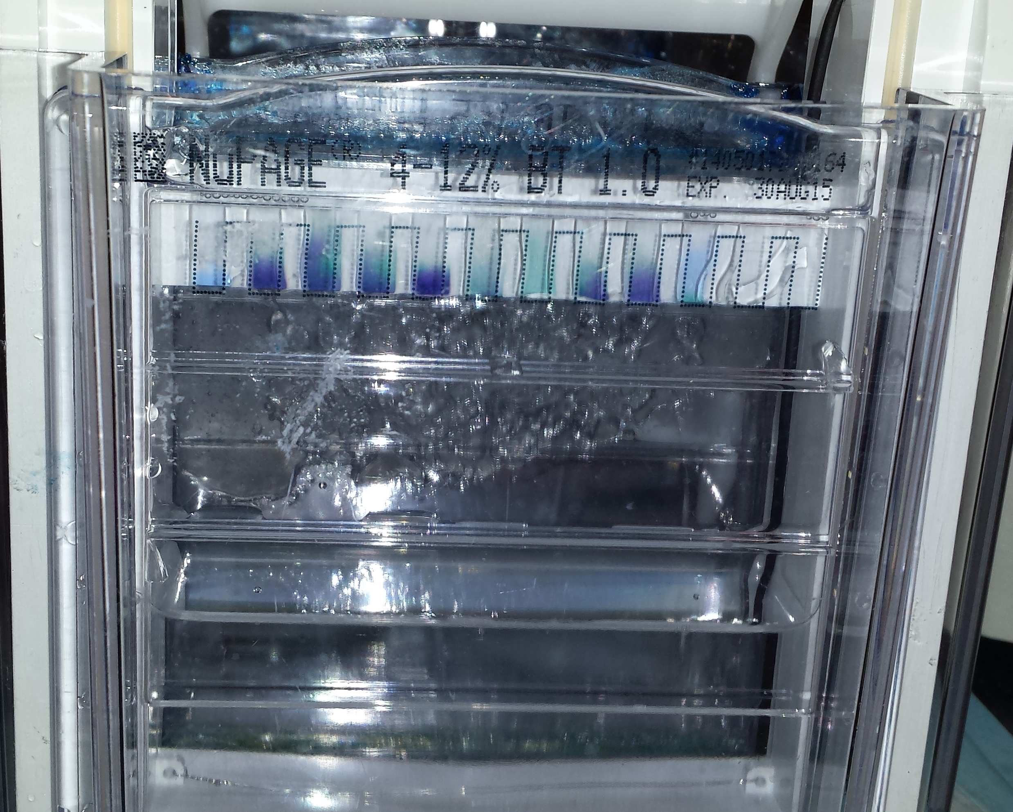
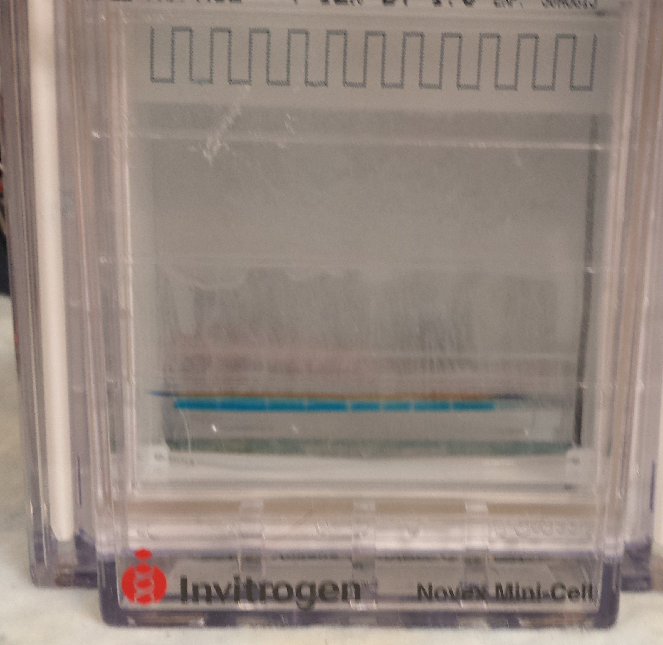
Lab Progress-Produce Proteins
Ran the protein across an SDS-PAGE gel

Slide 32
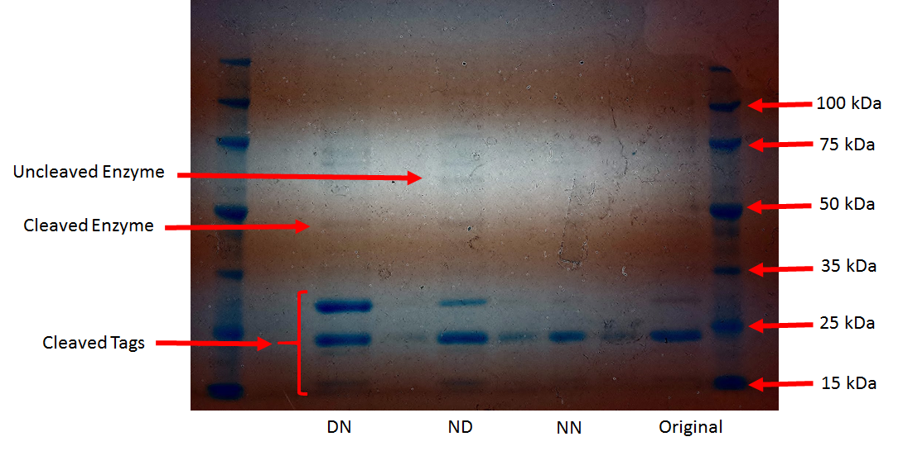
Lab Progress-Produce Proteins
Cleaved Proteins on Gel
Notes:
2 lower bands show cleaved tags added to facilitate folding and cleavage of tags off protein.
Next band is cleaved enzyme
Next is uncleaved enzyme—tags still on.
See other bands, we will run more stringent purification to see if they go away. DNA proteins often dimerize.

Slide 33
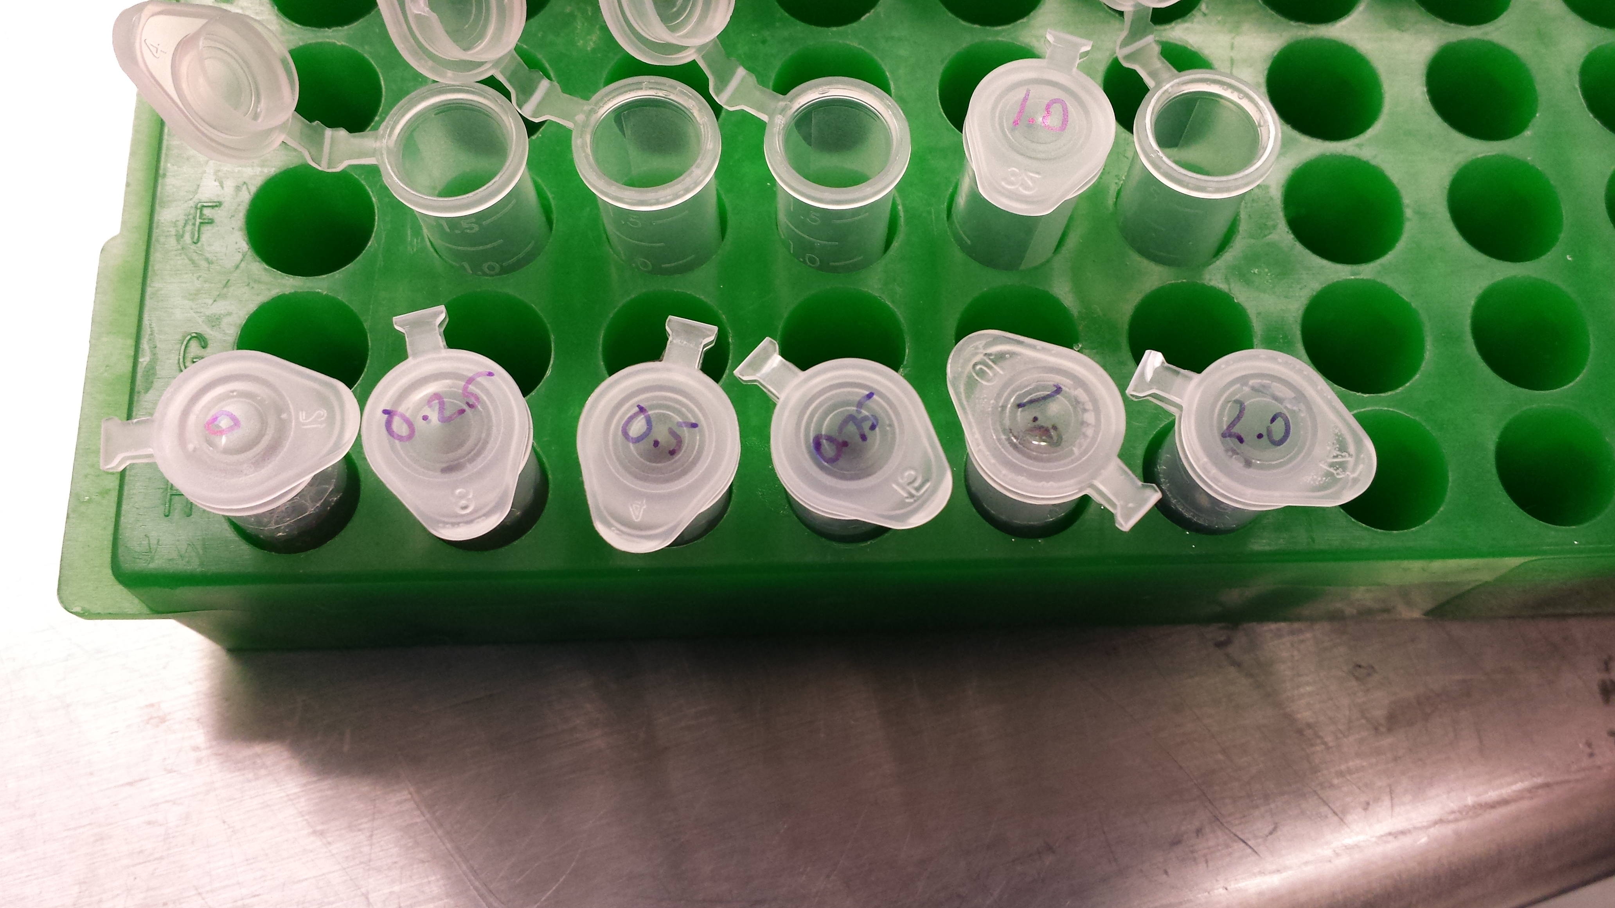
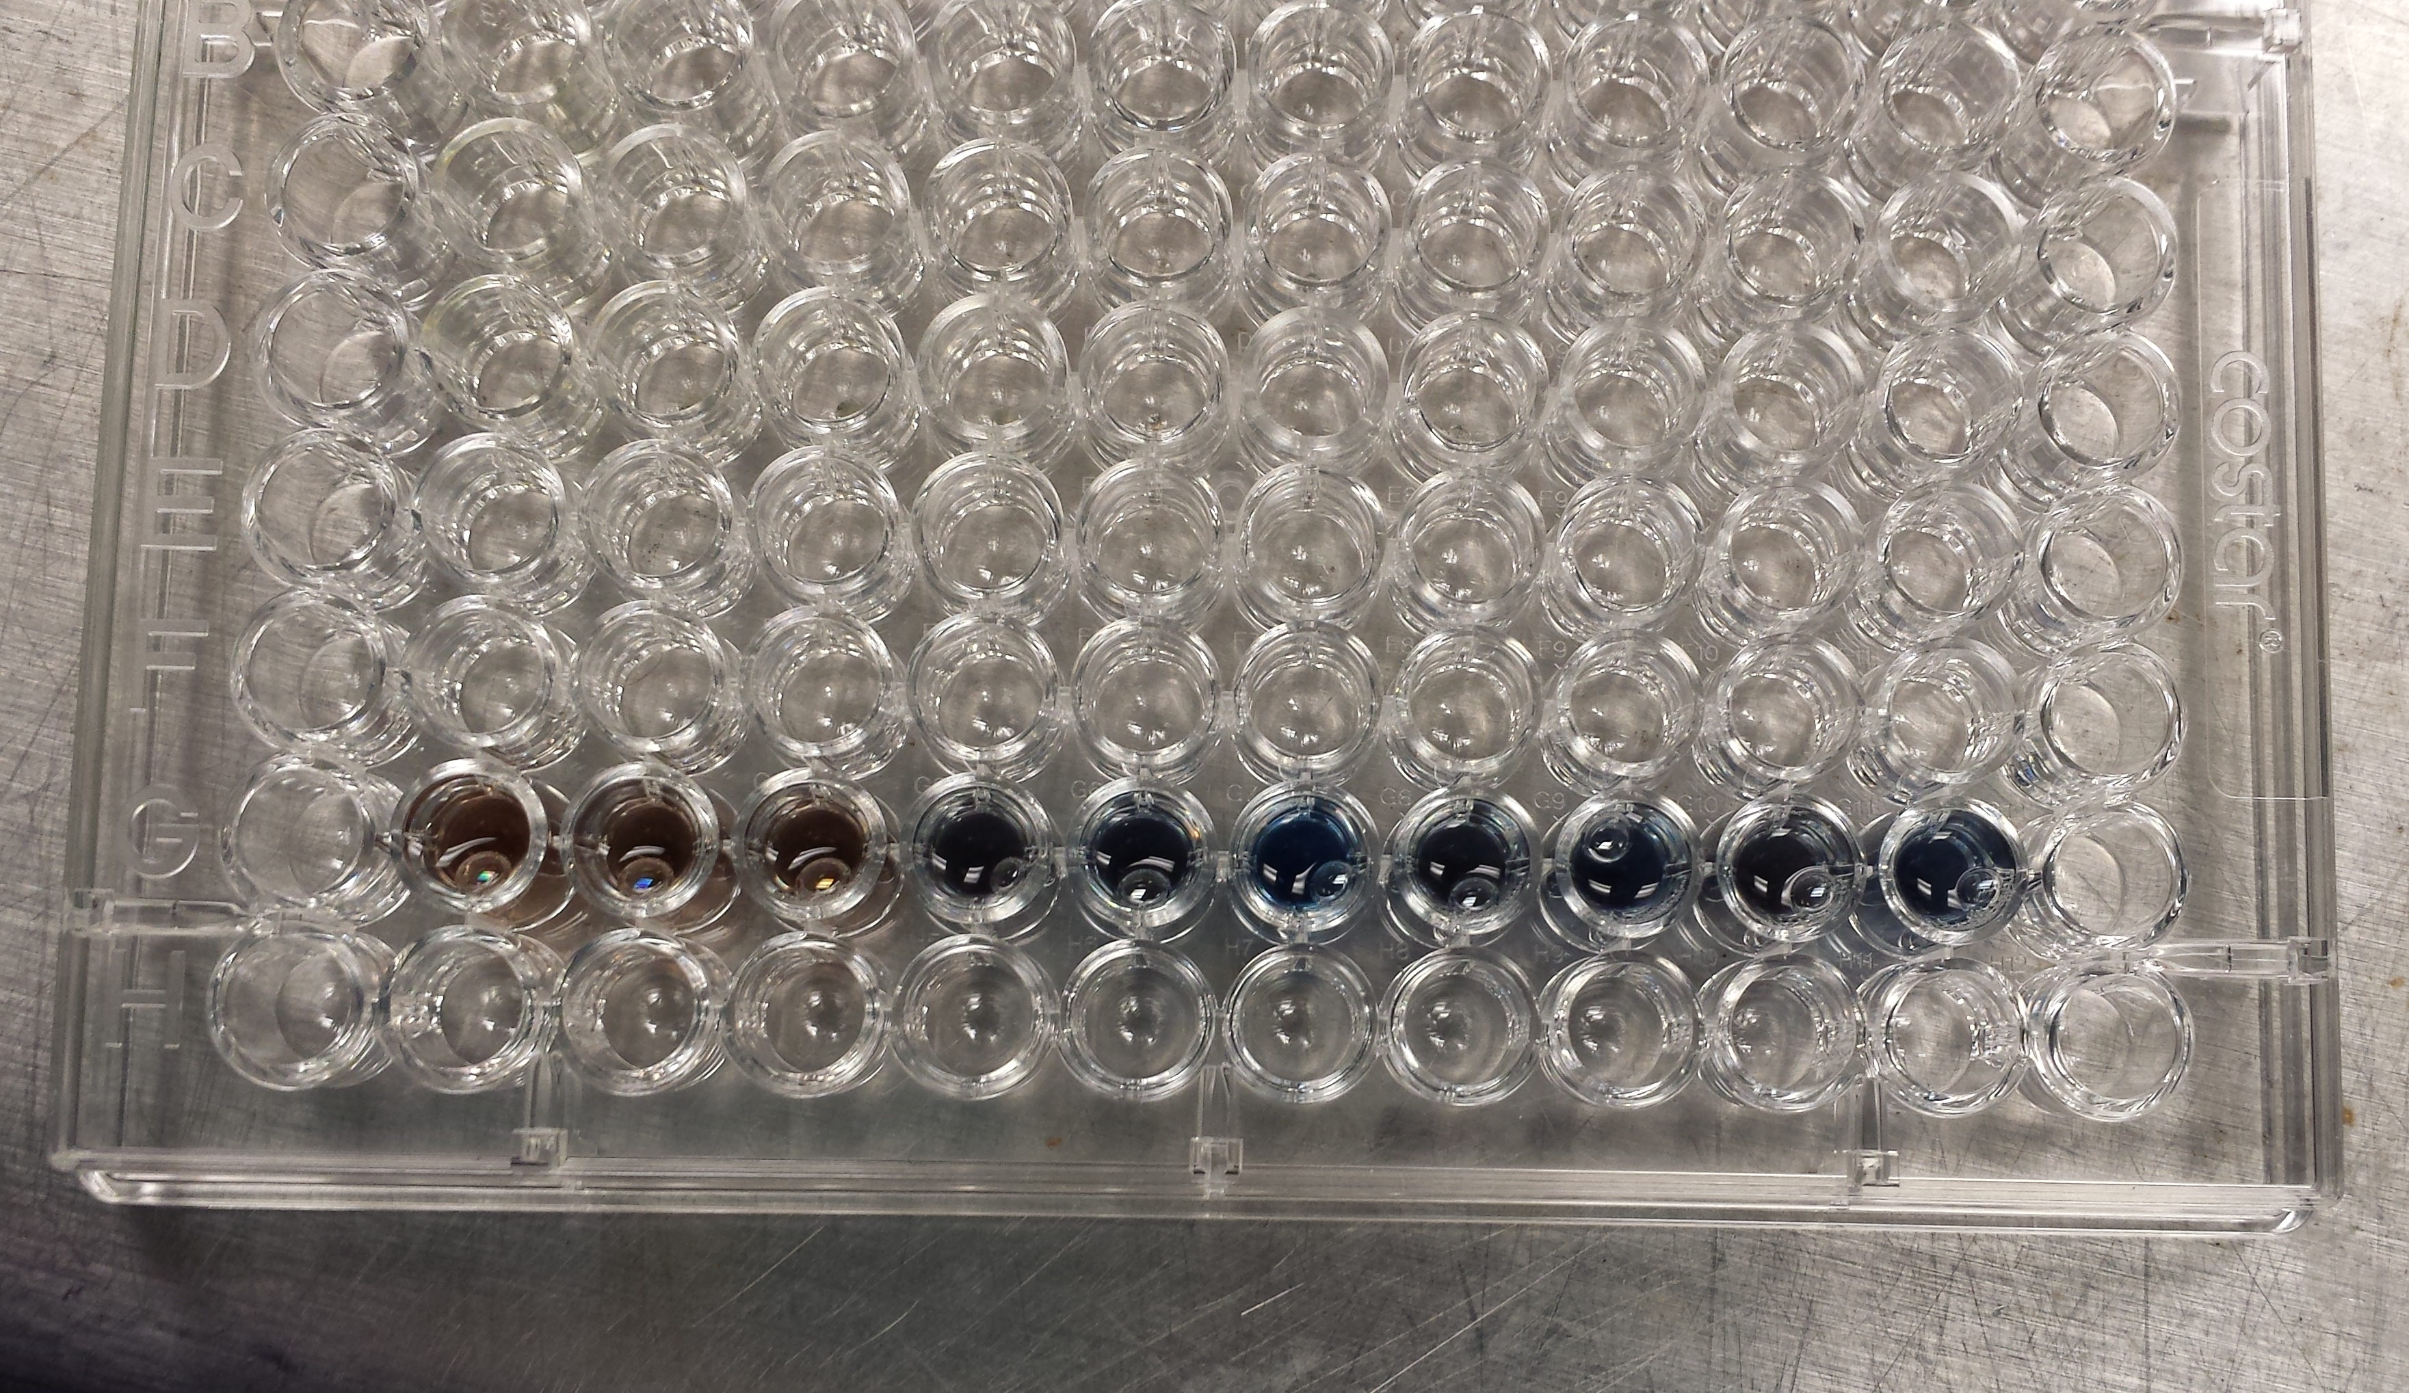
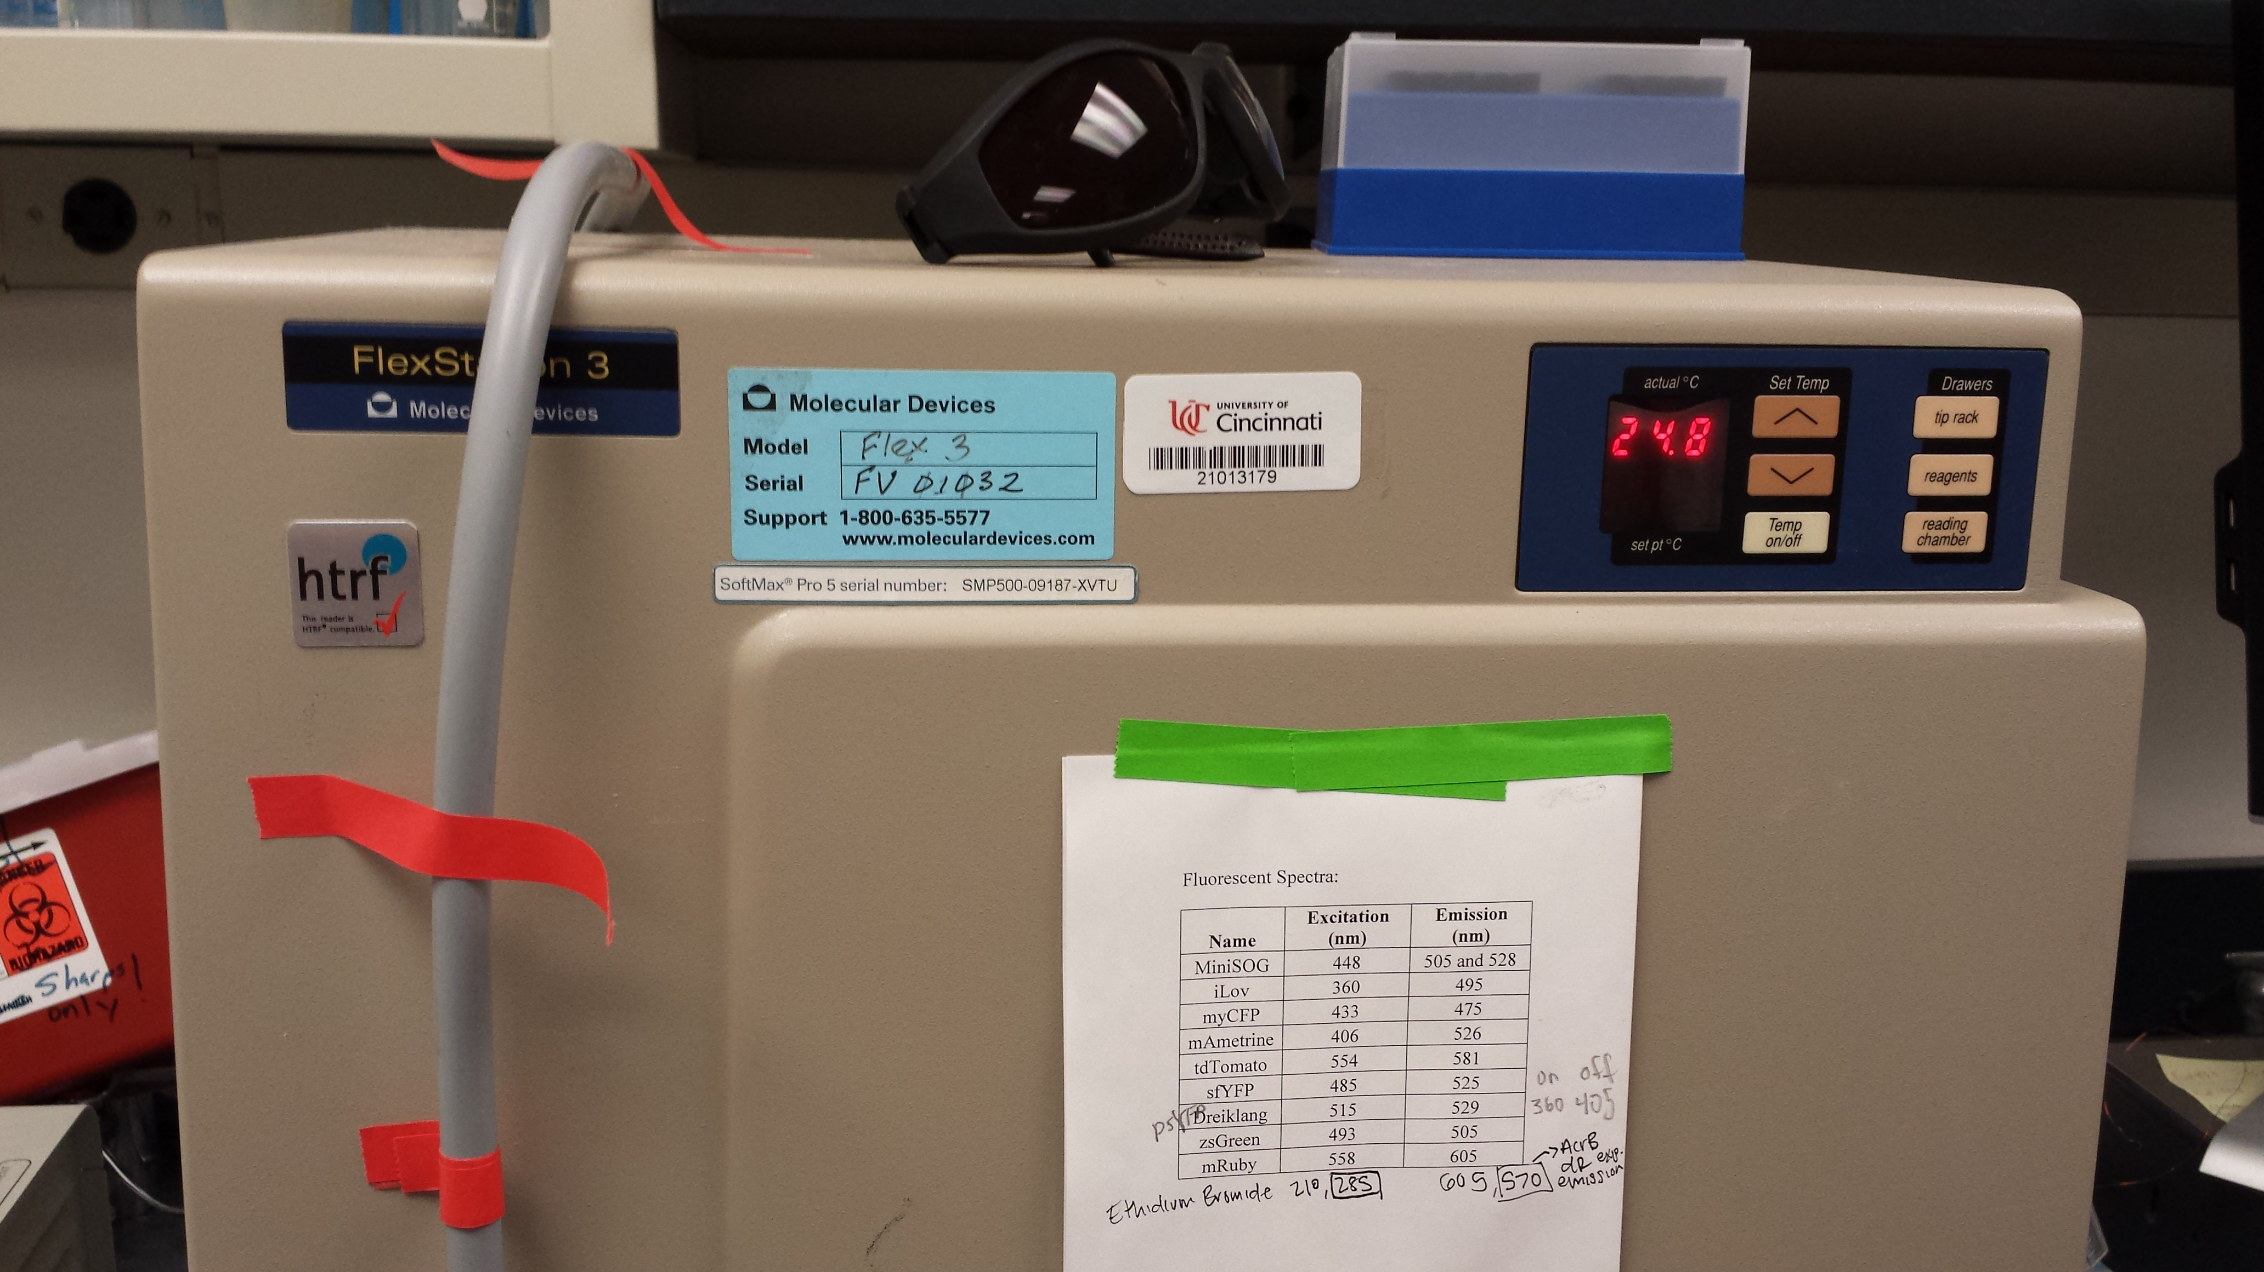
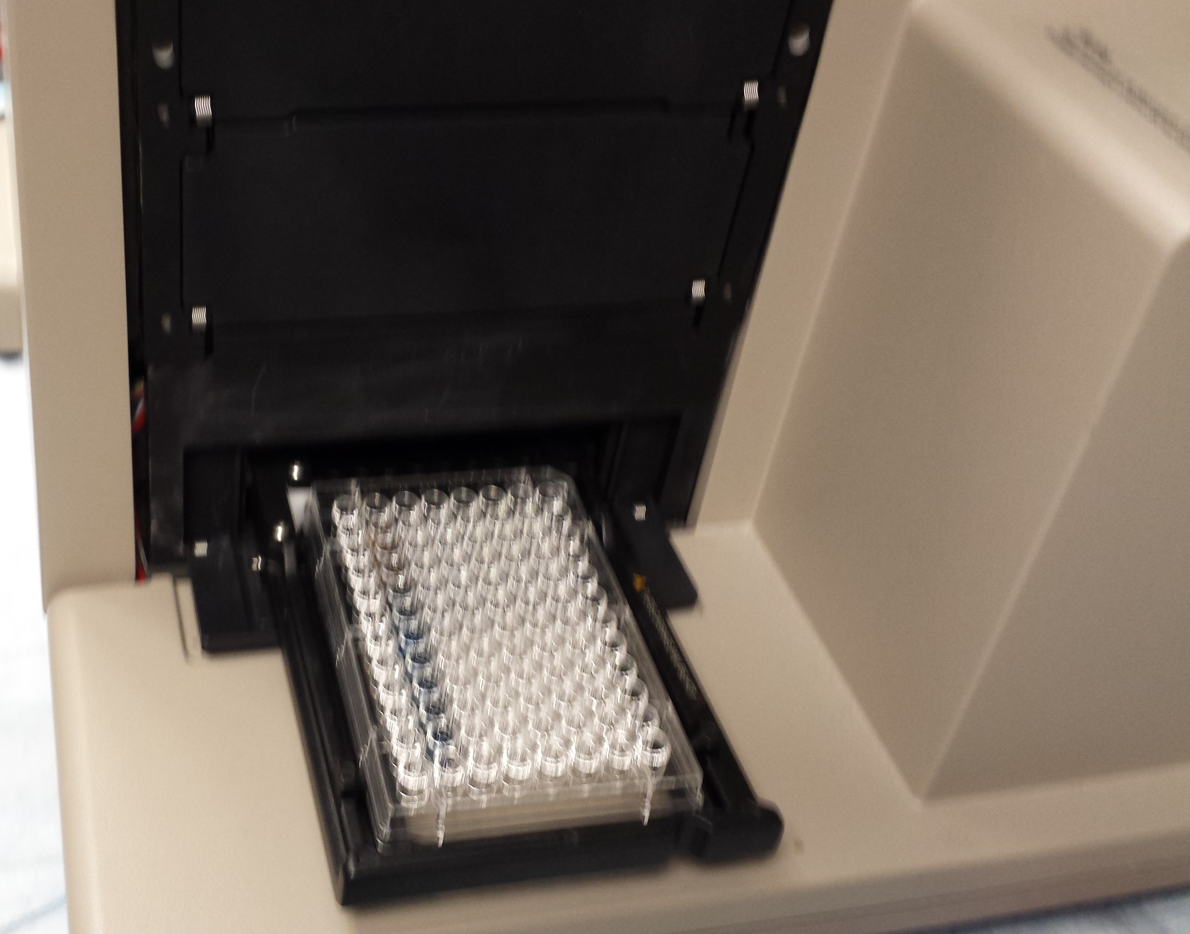
Lab Progress-Produce Proteins
The absorbencies of the purified proteins were compared to known concentrations of protein.

Slide 34
Lab Progress-Produce Proteins
Protein Concentration Values
 | DN | ND | NN | Original
Absorbance at 595 nm | 0.962756 | 1.050267 | 0.895467 | 1.067133
Concentration of Protein (mg/mL) | 1.027088 | 1.251037 | 0.854889 | 1.294201

Slide 35
Lab Progress-Enzyme Testing
Enzyme Activity Testing:
Mixed enzyme, buffer, and plasmid
60˚C
37˚C
Notes:
Solid band = no cleaving (Buffer)
Empty band = all cleaved (commercial enzyme)
Smeared bands = some cleaving (lab enzymes)

Slide 36
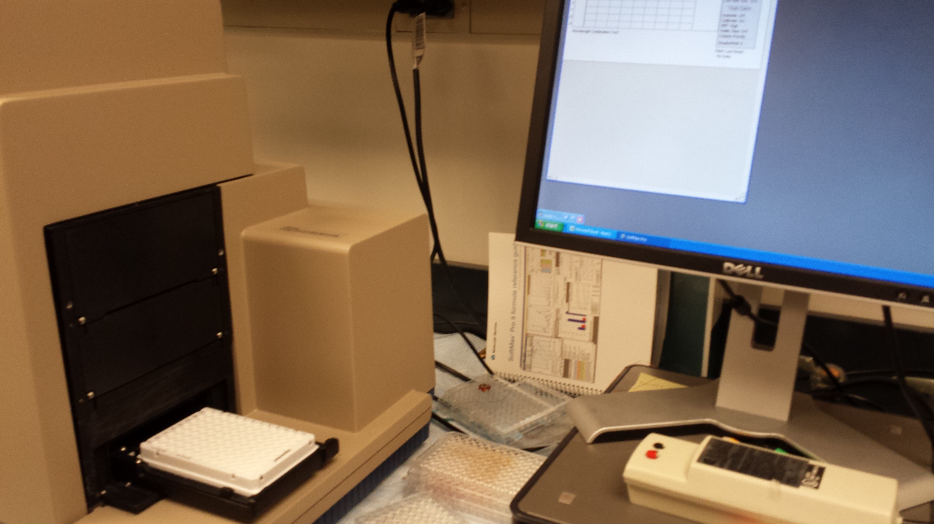
Lab Progress-Enzyme Testing
Fluorescence Testing: Recorded light emitted from mixture of enzyme, RNA mock norovirus, buffer and fluorescent probes

Slide 37
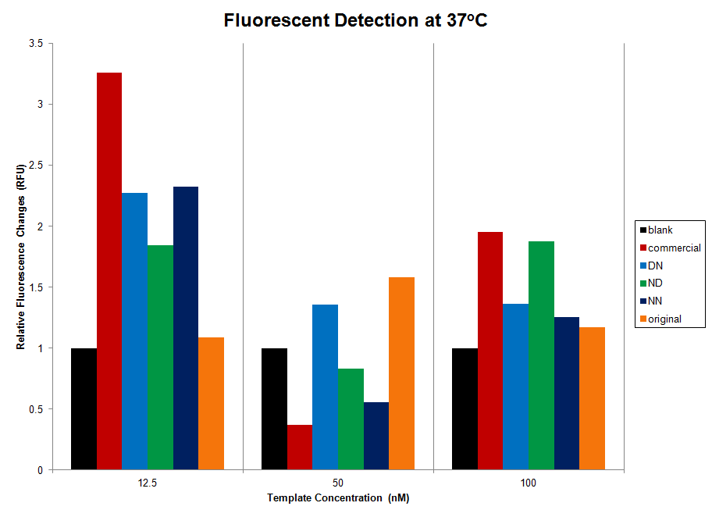
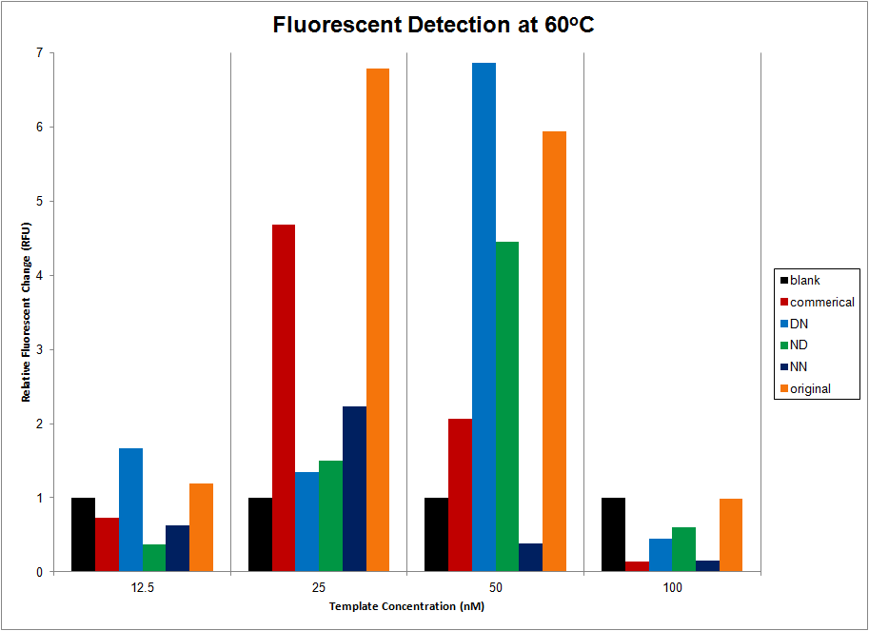
Lab Progress-Enzyme Testing
Compare 37˚C vs. 60˚C
Higher fluorescence signal measured at 60˚C
(optimum temperature of commercial enzyme)

Slide 38
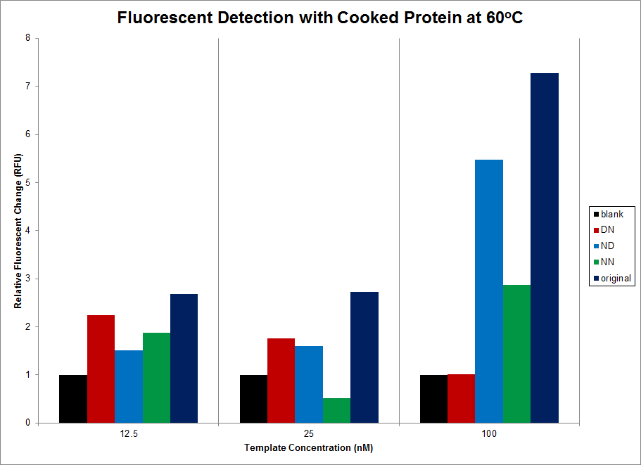
Lab Progress-Enzyme Testing
Comparing cooked vs uncooked protein
Removing non-thermostable material improved detection values
Indicates functional enzymes produced are thermostable

Slide 39
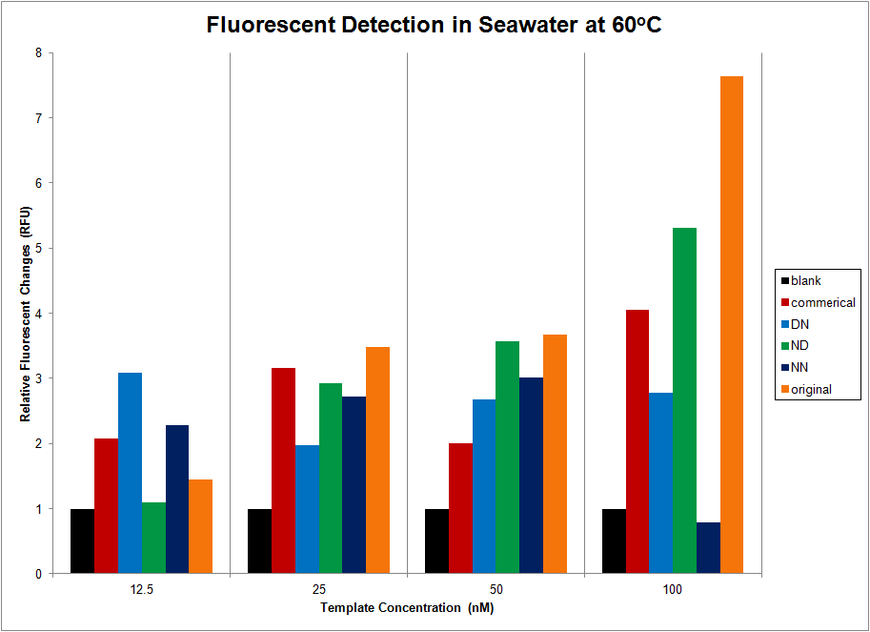
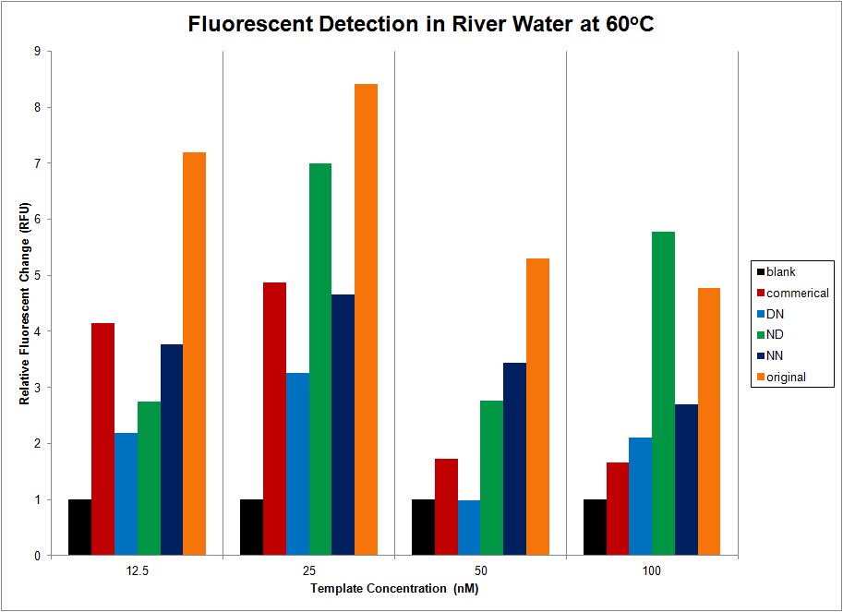
Lab Progress-Enzyme Testing
Seawater:
At 50nM, all 4 E.coli produced enzymes out-produced commercial
Increased template → increased detection
River water:
Increased detection vs. Nanopure water
Detection decreased with increased template

Slide 40
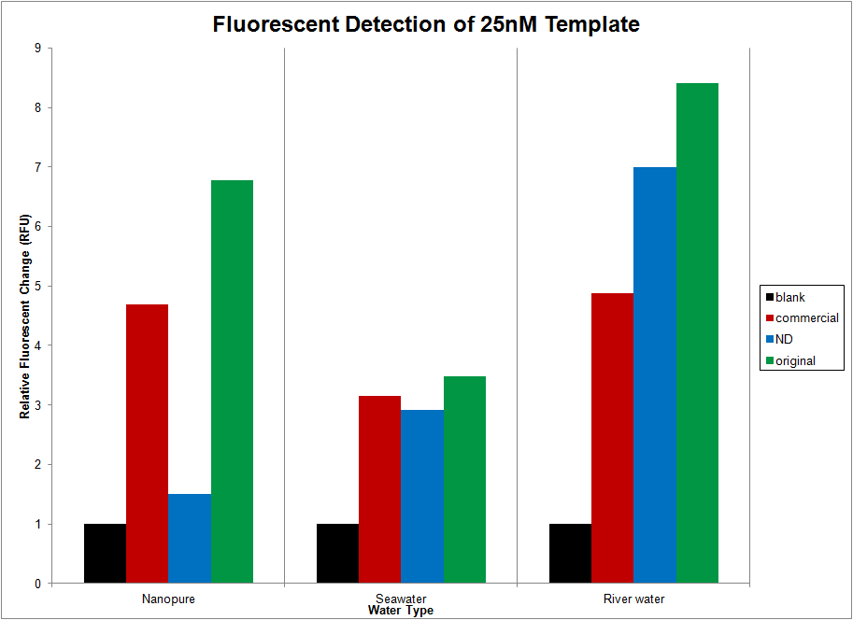
Lab Progress-Enzyme Testing
Comparing Nanowater, Seawater & River water
E.coli produced original enzyme → more signal than commercial enzyme in all types of water tested
Notes:
ND mutant shows the most signal in river water
River water is only medium in which ND produces more signal than the commercial enzyme.

Slide 41
Lab Progress-Enzyme Testing
DN
NN
Visible fluorescence signals enzyme activity
Buffer = no glow
Buffer
Seawater
Commercial
ND
Original
Buffer
DN
NN
River water
Commercial
ND
Original

Slide 42
Conclusions Drawn
First reported production of functional, soluble DSN in E. coli
All DSN mutants produced, DN, ND, & NN, were found to be thermostable with functionality at 60ºC and limited functionality at 37ºC.
Notes:
Cleavage of the N-terminal tags was observed in all DSN variants produced.
All E. coli produced enzymes retained some degree of functionality in nanopure water, seawater, and river water.

Slide 43
Conclusions Drawn
The ND mutant was found to be the best performing mutant, in some cases producing more fluorescent signal than the commercial enzyme.
Finally, the enzymes produced in this study were active on templates longer than 20 nucleotides, increasing the effective substrate range of native DSN.

Slide 44
Unit Plan—Carlson
Big Idea: Safe, drinkable water
Hook
World Vision water: Meet Violet and the other children of the Zambia Project
West Virginia chemical spill, Jan.,2014
300,000 residents without safe water for several days

Slide 45
Unit Plan—Carlson (cont.)
Justification
Past test scores and writing samples have shown that students struggle with the chemistry of life, including water, bonding, ions, proteins/enzymes, etc.

Slide 46
Unit Plan—Carlson (cont.)
Challenge
Design a self-contained, handheld water purification process that uses 3 filtration materials, to clean 500 ml of river water, contaminated with a harmless bacteria, within 5 minutes
The filter should remove color, odor and biotic and abiotic particles from the water. pH should be increased to 7-8.

Slide 47
Unit Plan—Carlson (cont.)
Lesson 1
Activity 1: The Big Idea, Essential ?s
Activity 2: Investigate Properties of Water
Lesson 2
Activity 3: Test different filter materials’ ability to clean water (EDP)
Activity 4: Challenge: Design a water filter (EDP & CBL)

Slide 48
Unit Plan—Ruder
Unit Title: The Biology of School Attendance
Big Idea: Life! It’s Complicated.
Essential Question: Are students sick of school or is school making students sick? How can we improve school attendance by preventing the spread of illness among students?

Slide 49
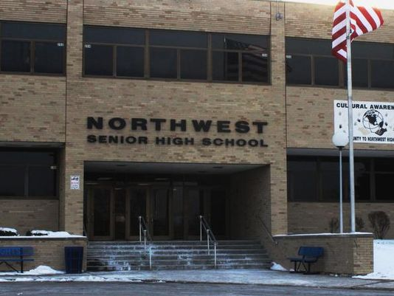
Unit Plan—Ruder (cont.)
Justification
Data indicates students struggle with: biotic vs. abiotic factors, and homeostasis, especially the importance of water.
Challenge:
Design a comprehensive method for reducing the spread of bacteria and viruses on school grounds.

Slide 50
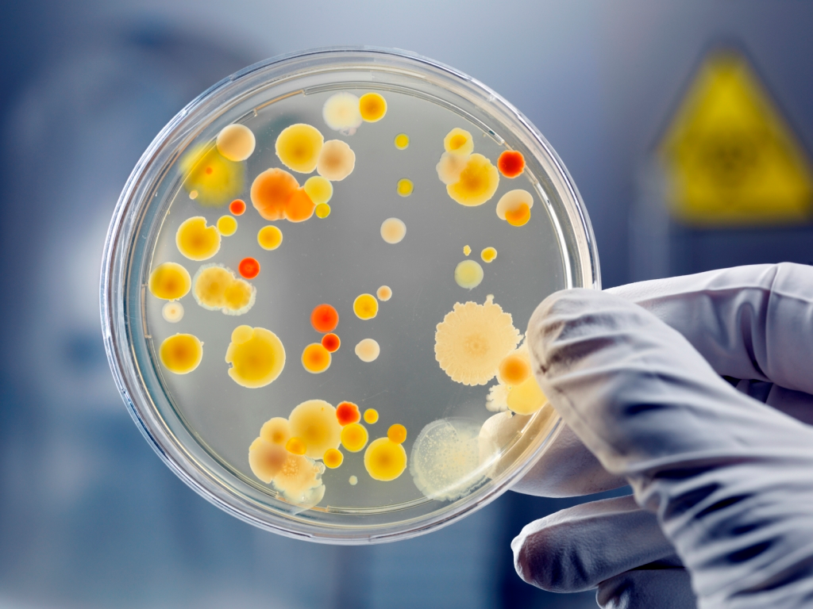
Unit Plan—Ruder: Lesson 1
Activity 1
Day 1: Hook, Essential Questions
Day 2: Challenge, Hand Sanitizer vs. Hand Washing
Day 3: Data analysis
- Attendance
- Personal Hygiene Survey
Notes:
Flipped Lesson: Properties of Water ppt with guided notes.

Slide 51
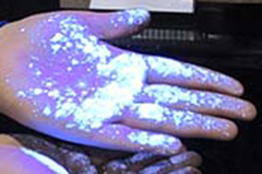
Activity 2
Unit Plan—Ruder: Lesson 1
Day 4: Properties of Water
Day 5: Glo germ
Day 6: Share solutions/feedback
Day 7: Redesign
Notes:
Koolaid, penny, wax/glass
EDP: personal hygiene and campaign

Slide 52
Activity 3
Unit Plan—Ruder: Lesson 2
Day 8: Research Characteristics of Life
Day 9: Research cont.
Day 10: Share research

Slide 53
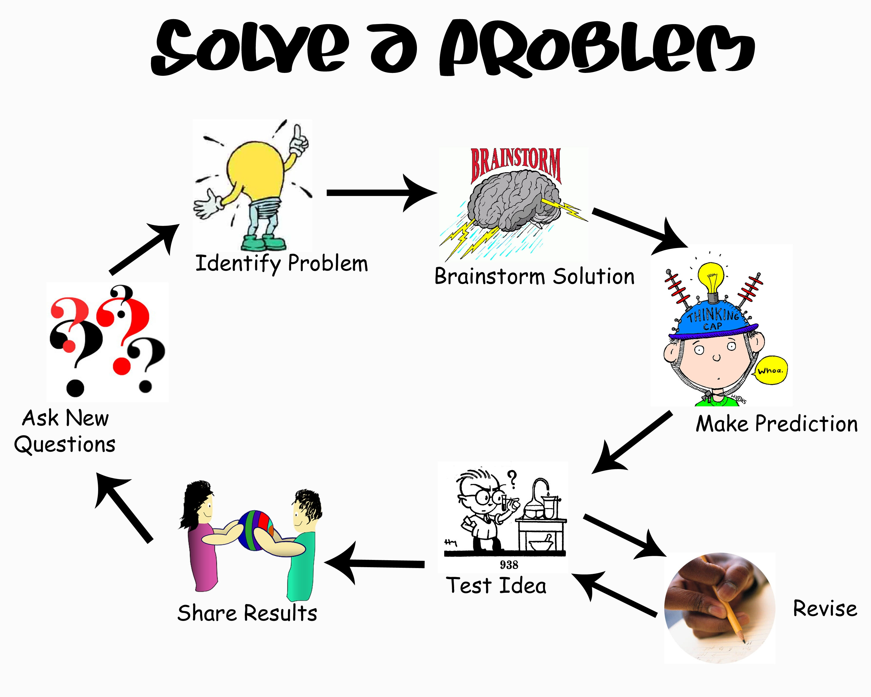
Activity 4
Unit Plan—Ruder: Lesson 2
Day 11: Survey School Grounds
Day 12: Select Facility redesign
Day 13: Share solutions/feedback
Day 14: Redesign, Final solutions

Slide 54
Acknowledgements
RET is funded by the National Science Foundation, Grant ID # EEC-1404766. Any opinions, findings, and conclusions or recommendations expressed in this material are those of the authors and do not necessarily reflect the views of the National Science Foundation.

Slide 55
References
http://www.cdc.gov/norovirus/lab-testing/diagnostic.html
Farkas,T., Tan,M.,and Jiang,X. (2008). “Norovirus gastroenteritis.” Emerging Infections 8, ASM Press, Washington, D.C., 39-52
Jafar Mazumder, M.A., and Al-Ahmed,A.,(2013) “Advances in molecular technologies and platforms for the diagnosis of infectious diseases.” Advanced Materials Research.810, 77-125.
Wang, J., Xu, Z., Niu, P., Zhang, C., and Zhang, J. (2014) “A two-tube multiplex reverse transcription PCR assay for simultaneous detection of viral and bacterial pathogens of infectious diarrhea.” BioMed Research International, 2014, 1-9.
Wilhelm, B., Leblanc,D., Houde,A., Brassard,J., Gagné,M., Plante,D., Bellon-Gagnon,P., Jones,T.H., Muehlhauser,V., Janecko,N., Avery,B., Rajić,A., McEwen,S.A. (2014). “Survey of Canadian retail pork chops and pork livers for detection of hepatitis E virus, norovirus, and rotavirus using real time RT-PCR.” International Journal of Food Microbiology, 185, 33-40
Yin, B., Liu, Y., Ye, B. (2012). "One-step, multiplexed fluorescence detection of microRNAs based on duplex-specific nuclease signal amplification." Journal of the American Chemical Society, 134(11), 5064-5067.

